Slide 1
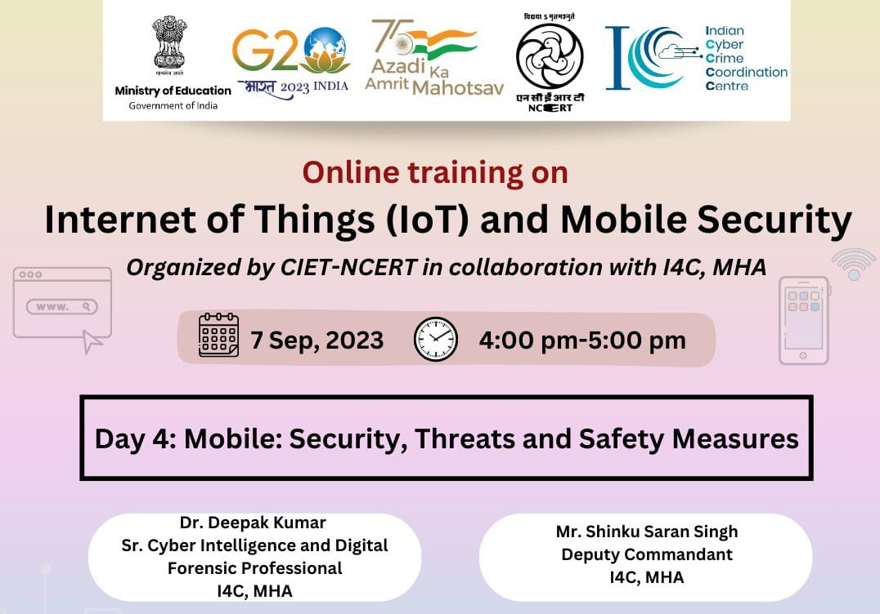

Slide 2
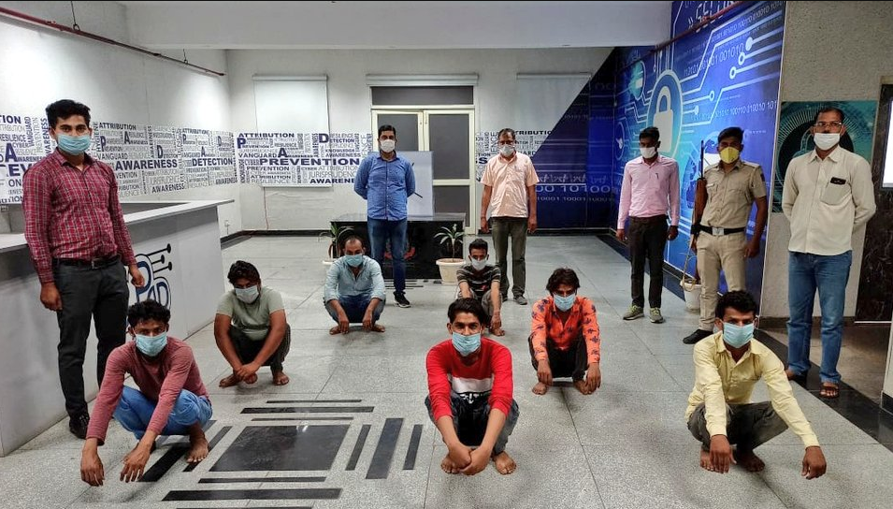
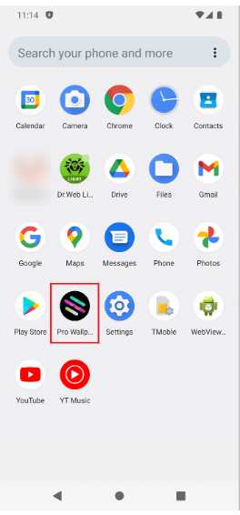
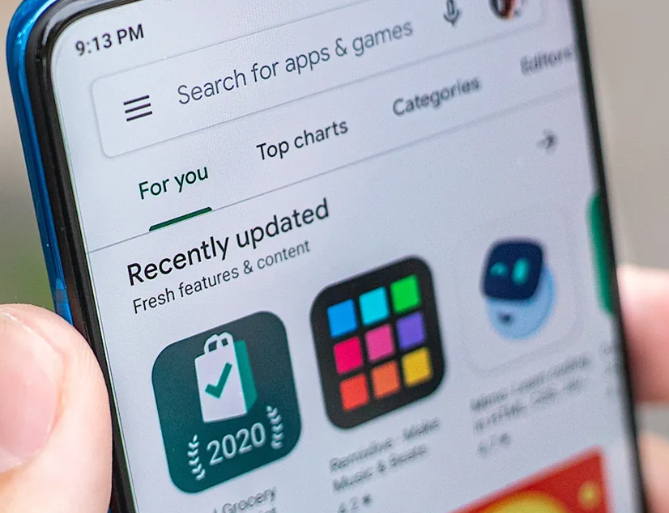
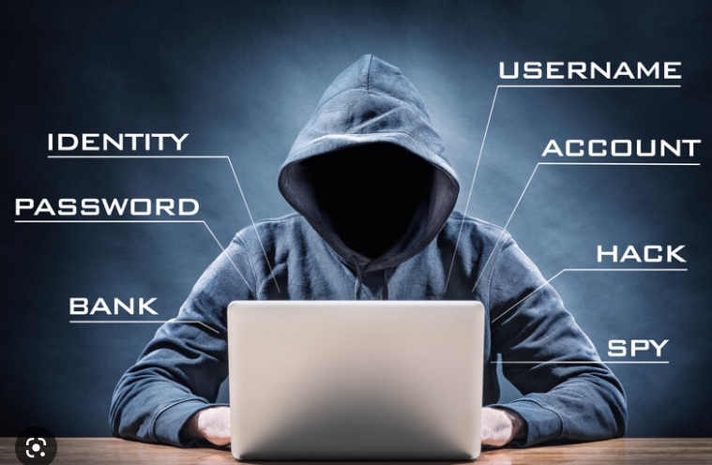
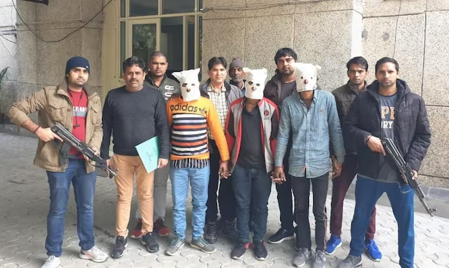
Shifted from vishing to mobile app

Slide 3
MOBILE THREATS
Threat actors are using newly discovered “SandStrike spyware” and delivered via a malicious VPN application to target Android users
https://www.bleepingcomputer.com/news/security/new-sandstrike-spyware-infects-android-devices-via-malicious-vpn-app/ Nov 2022
Meta uncovers 400 malicious apps on Android and iOS apps, Fraudsters are stealing Facebook users' information through malicious apps downloaded from Apple and Google's software stores
https://www.scmagazine.com/analysis/application-security/meta-uncovers-400-malicious-apps-on-android-and-ios-apps Oct 2022
New ERMAC 2.0 banking Android Trojan malware steals accounts, wallets from 467 apps to steal account credentials and crypto wallets.
https://www.bleepingcomputer.com/news/security/new-ermac-20-android-malware-steals-accounts-wallets-from-467-apps/ May 2022
Experts Uncover 85 Apps with 13 Million Downloads Involved in Ad Fraud Scheme
https://thehackernews.com/2022/09/experts-uncover-85-apps-with-13-million.html?m=1
Sep 2022

Slide 4
RED FLAGS
Instant loan
work from home
electricity fraud
nude call sextortion
WhatsApp impersonation
OLX frauds
Smishing
Vishing
Phishing websites
Online social media
Fake advertisements
The first stage of gathering contacts could by followed by mass-phishing via text messages.
Fake e-commerce websites, phishing campaigns, data & credential harvesting
Fake SMS Headers & Bombers contains short links of WhatsApp example: wa.me/919560348xxx
Domains mimicking (look alike, name and logo) popular Android app and services, brands

Slide 5
METHODOLOGY
Furnished in many folds Instant loan, work from home, electricity fraud, nude call sextortion, WhatsApp impersonation, etc.
Propagating through Smishing, Vishing, Phishing of online social media websites and Luring by fake advertisements
The first stage of gathering contacts could by followed by spear phishing via text messages.
URL shared through telegram channels, groups, referral
If they download the app, they are met with a permission request that demands complete control of their device.
Designed to run silently in the background, constantly spying on its victims without raising suspicion

Slide 6
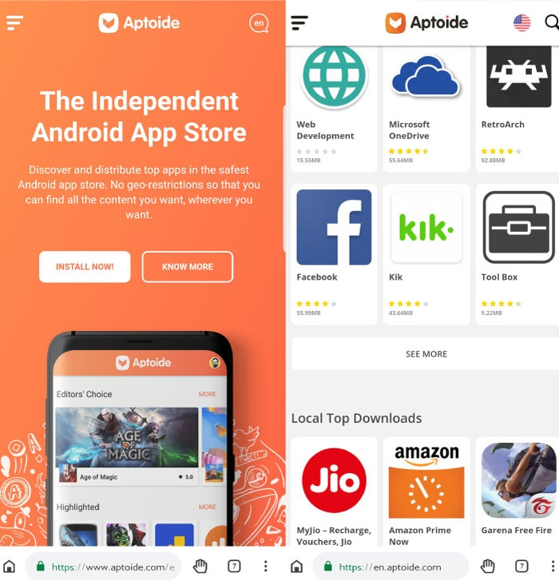
Categorised app based frauds
Loan App
Dating App
Gaming App
Screen Sharing / Remote Access Apps
Covid-19 Apps
E-Shopping Apps
Social Media Apps
Unknown / Unverified (Fake) Apps

Slide 7
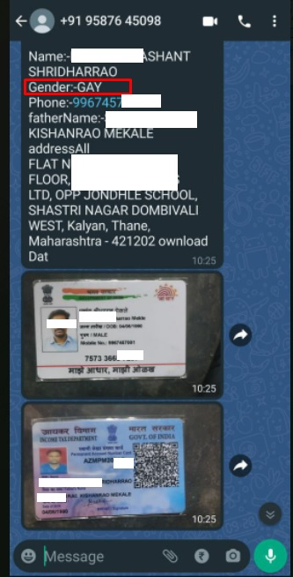
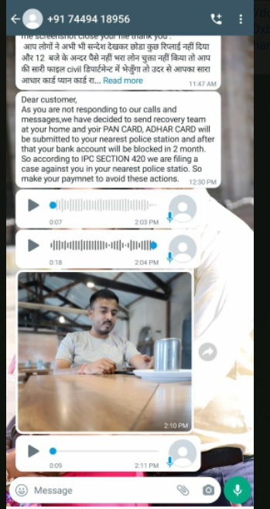
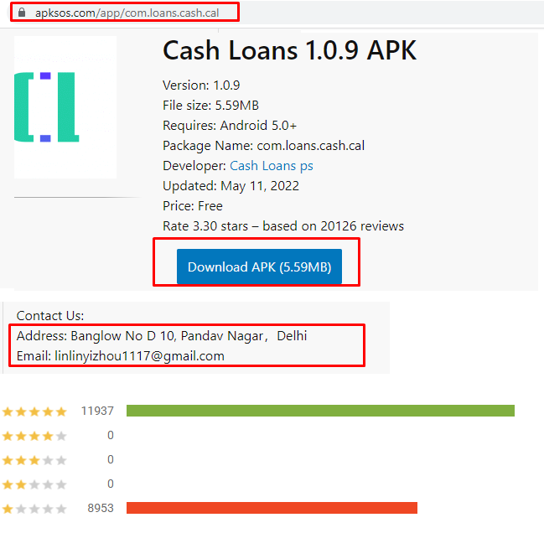
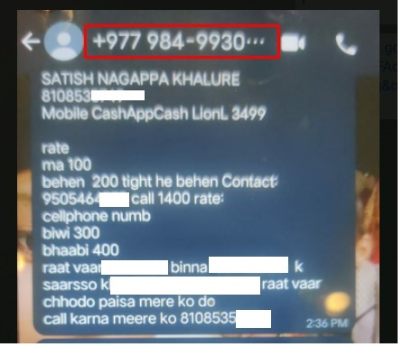
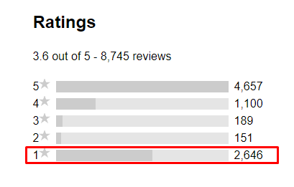
Loan App Frauds

Slide 8
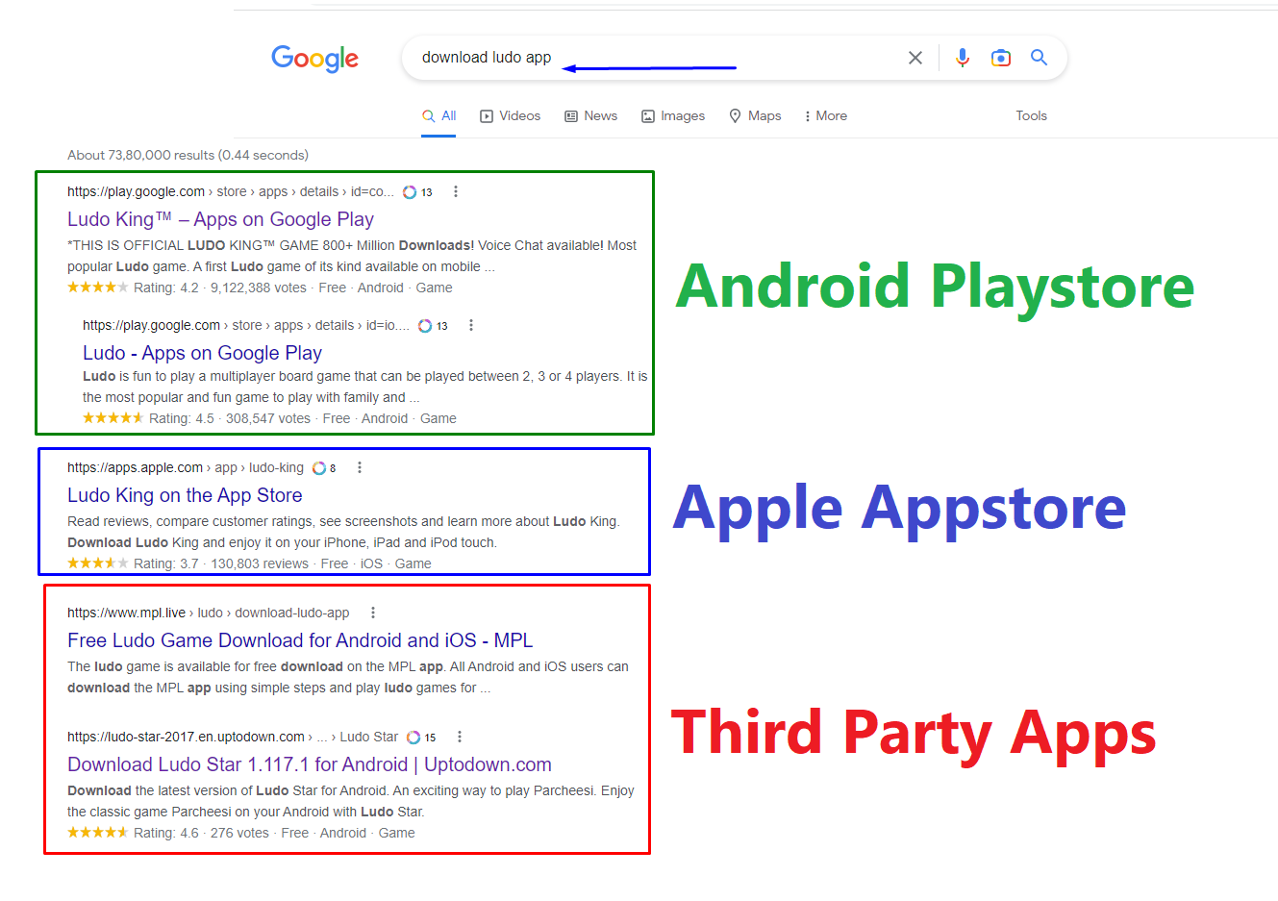
MOBILE APPLICATIONS

Slide 9
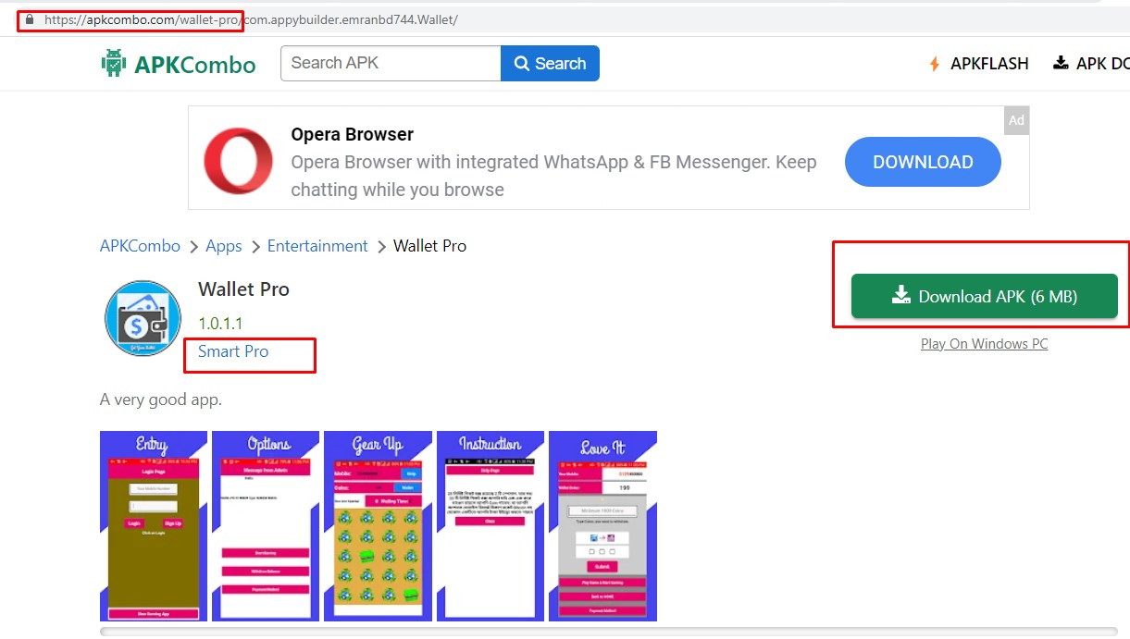
Third Party Apps

Slide 10
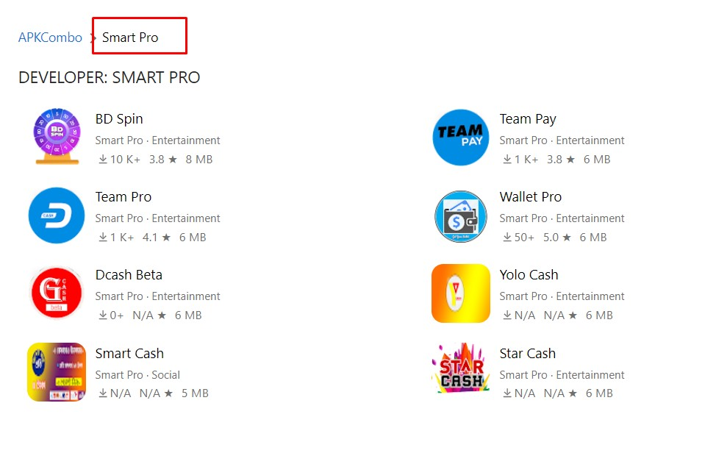
Third Party Apps

Slide 11
EXAMPLE 1

Slide 12
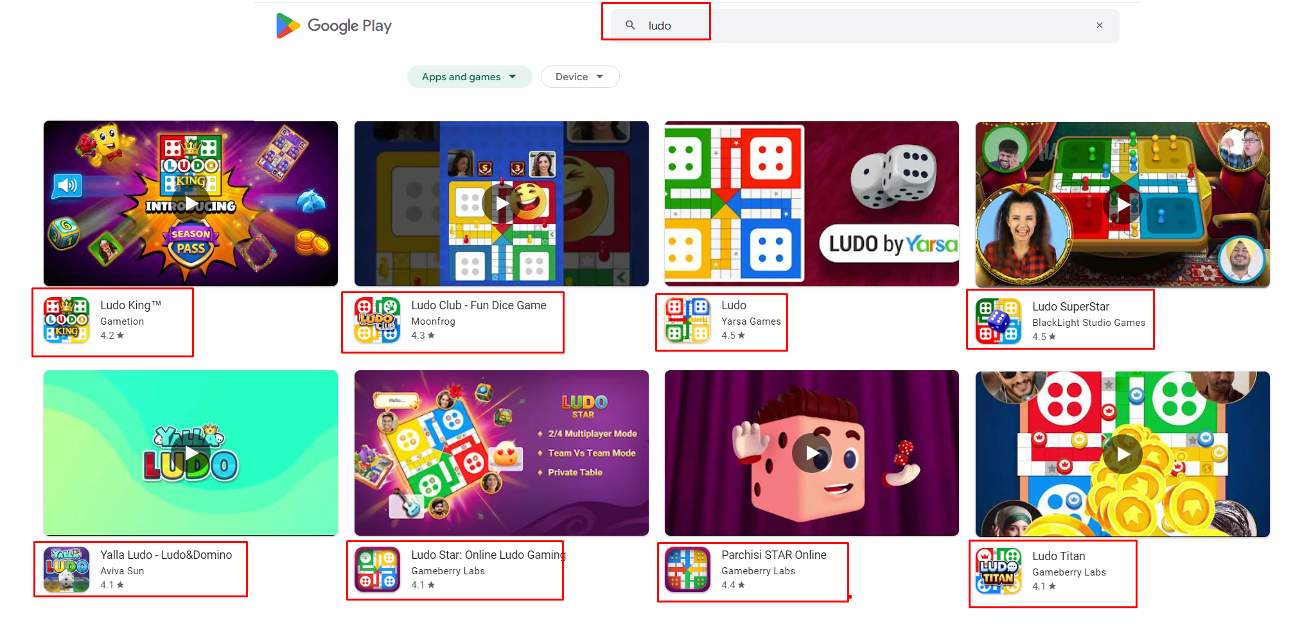
Understand the mobile app

Slide 13
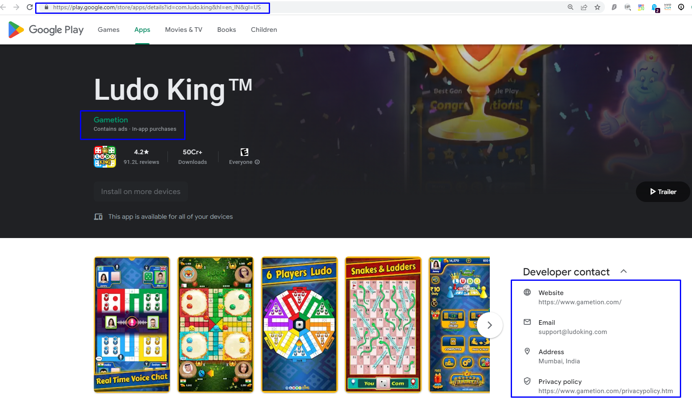
Scenario 1

Slide 14
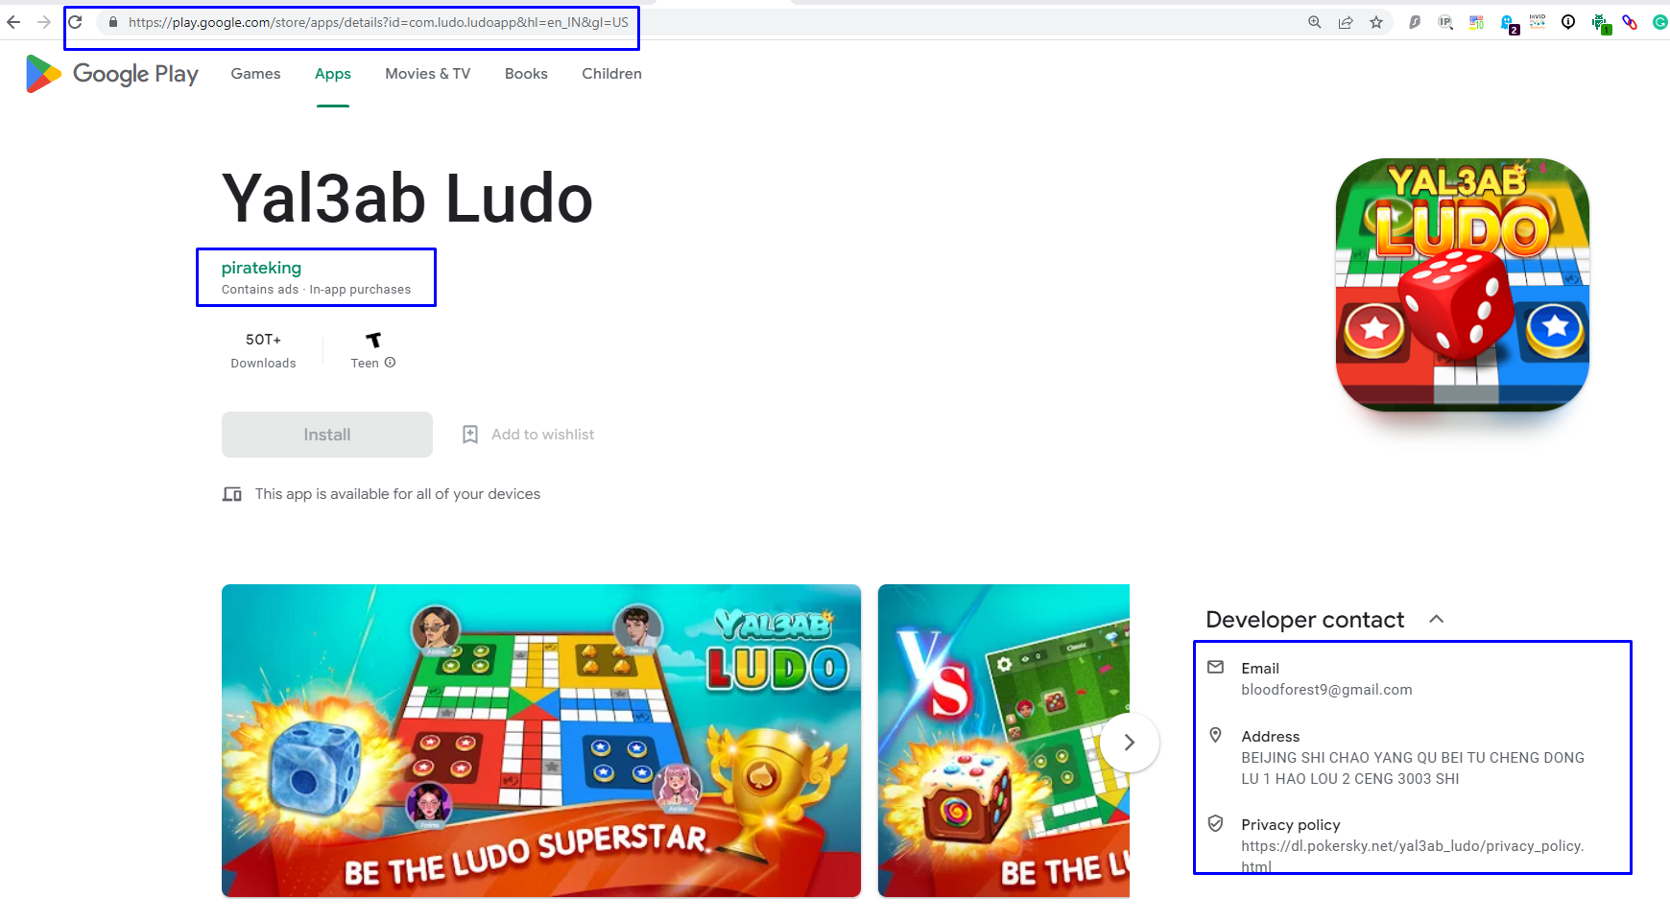
Scenario 2

Slide 15
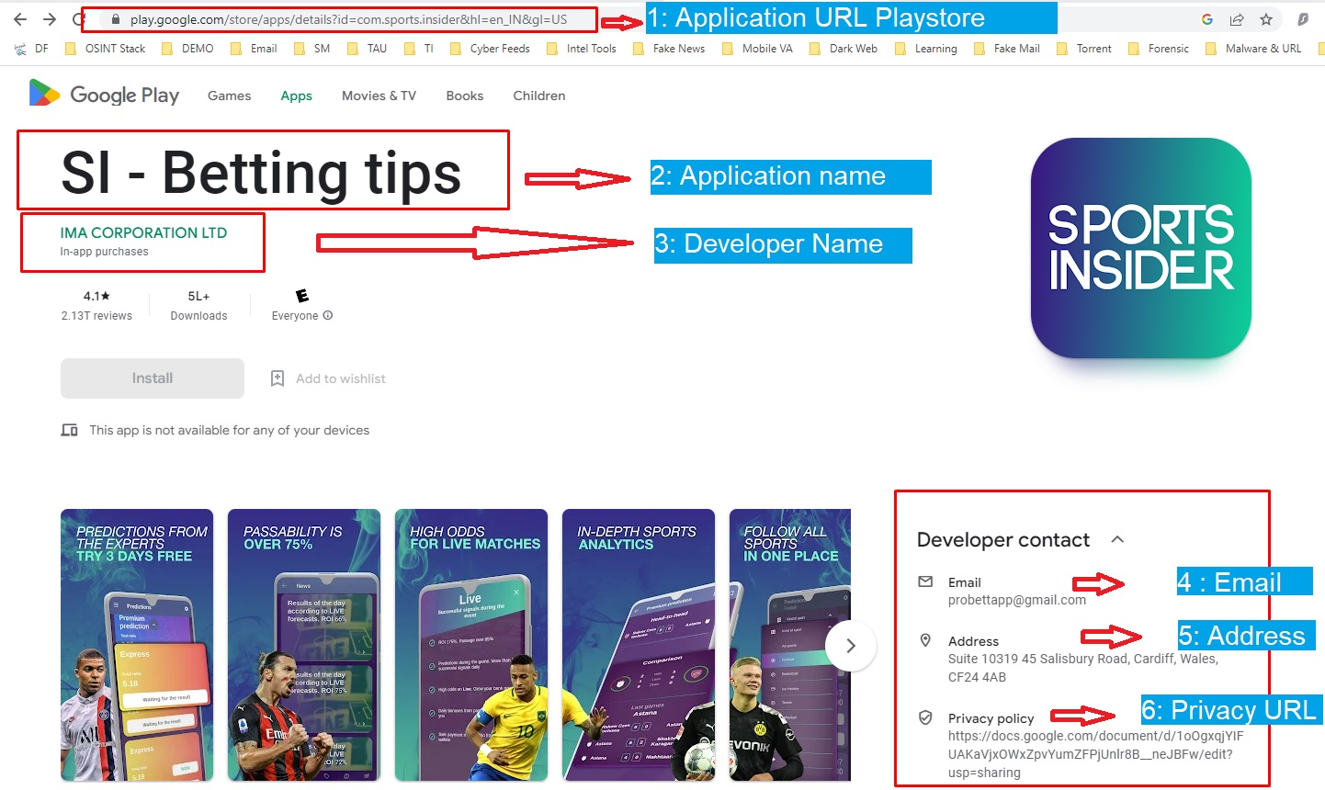
Observation

Slide 16
EXAMPLE 2

Slide 17
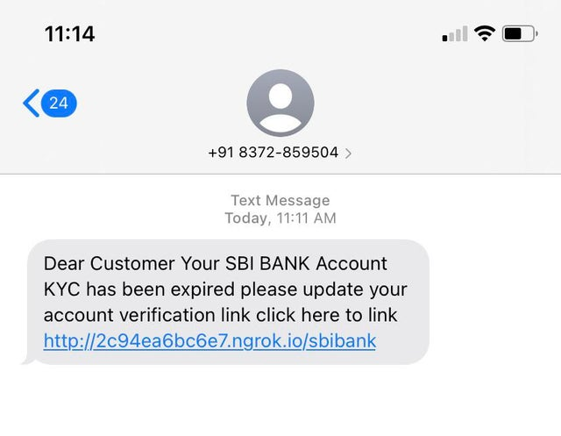
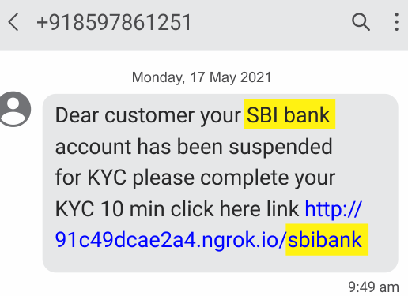
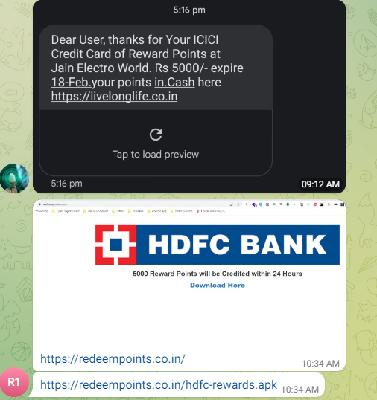
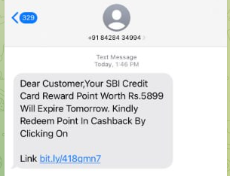
ATTACK METHOD
Restricted

Slide 18
Restricted
SMS Phishing link URL redirected to Malicious APK

Slide 19
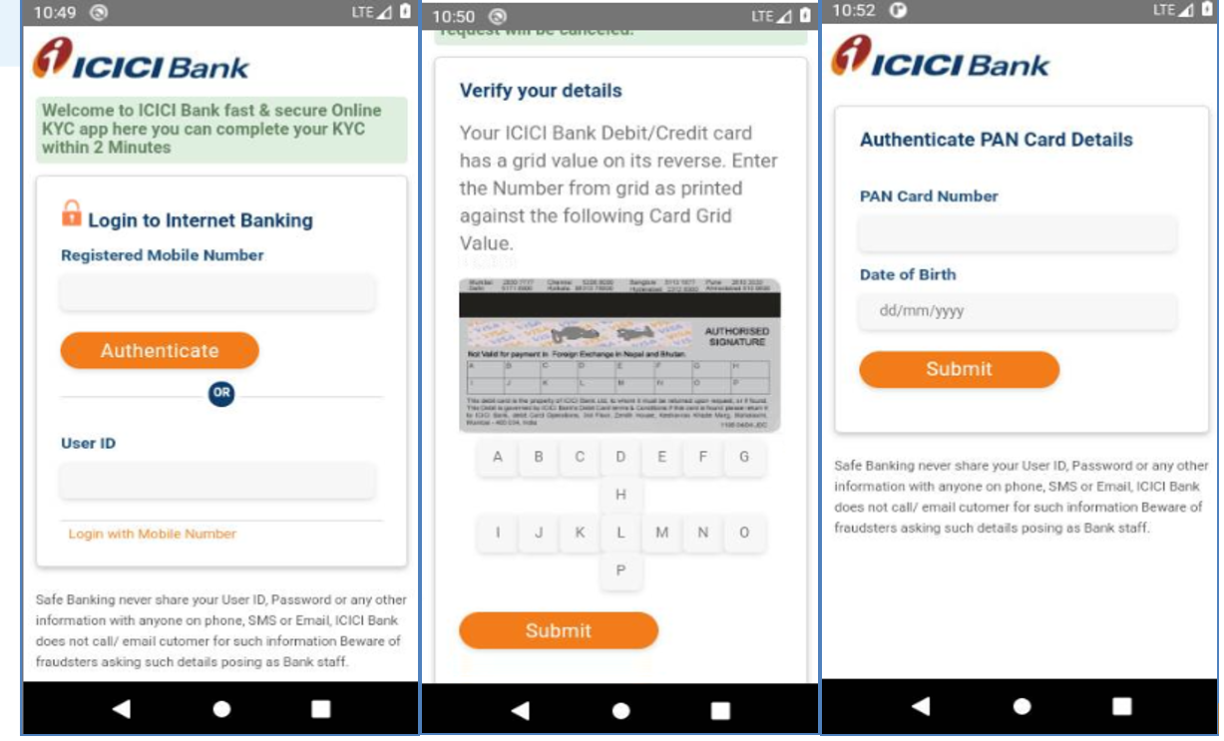
Restricted
The application is asking for the user’s sensitive information like login credentials, credit/debit card grid value (printed on the card), PAN number, Date of Birth, etc.

Slide 20
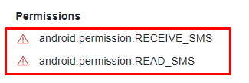
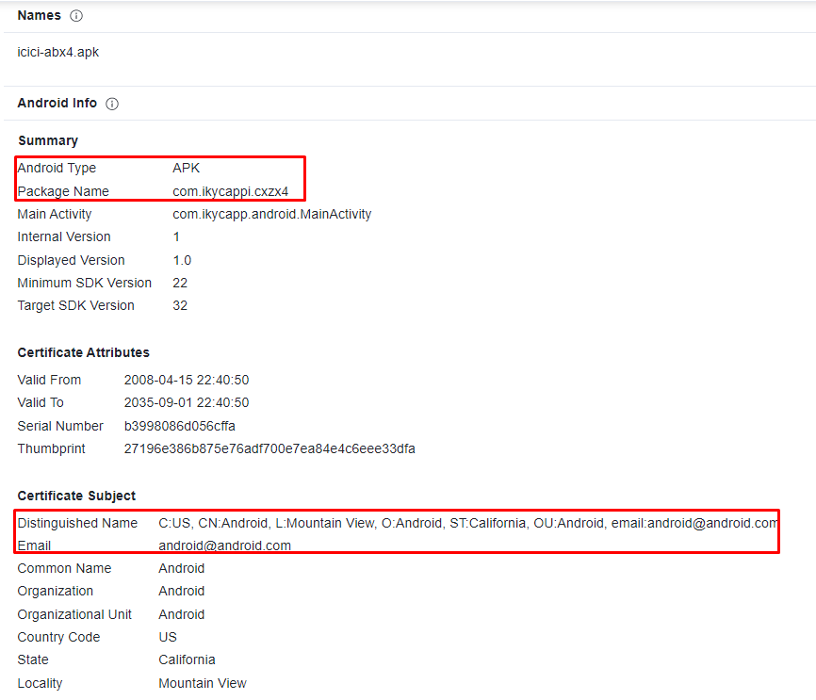
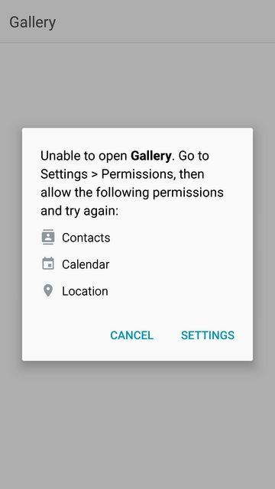
Restricted
Malicious Payload hosted on ‘web.app’ : https://icku-fx.web.app/icici-abx4.apk

Slide 21
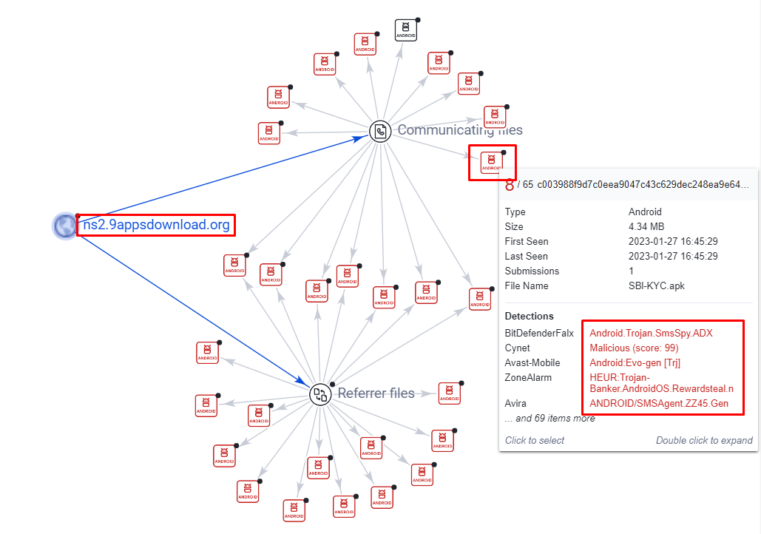
Restricted
Hosting templates on
phishing Server/Domains

Slide 22
EXAMPLE 3

Slide 23
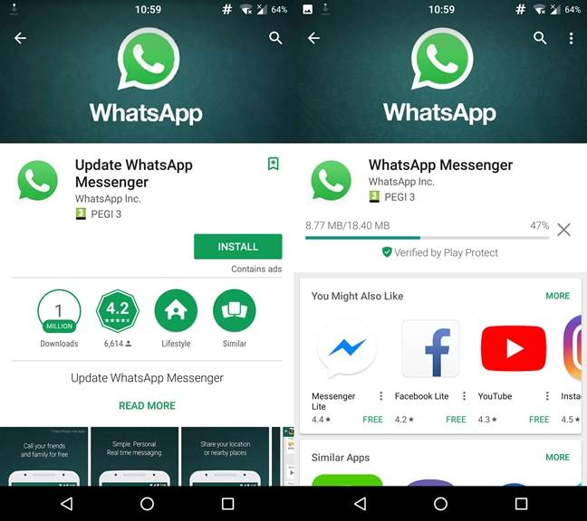
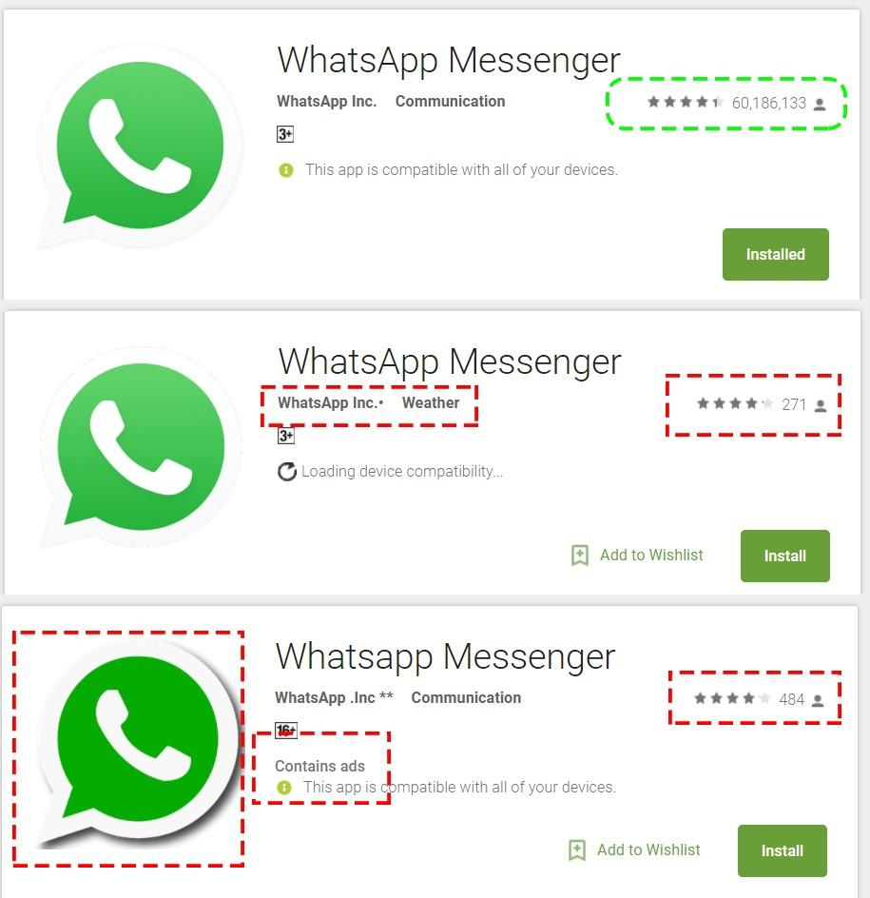
Example

Slide 24
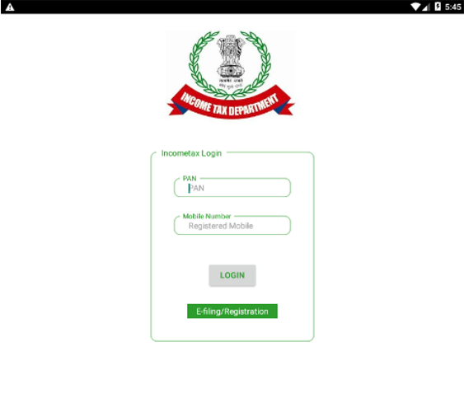
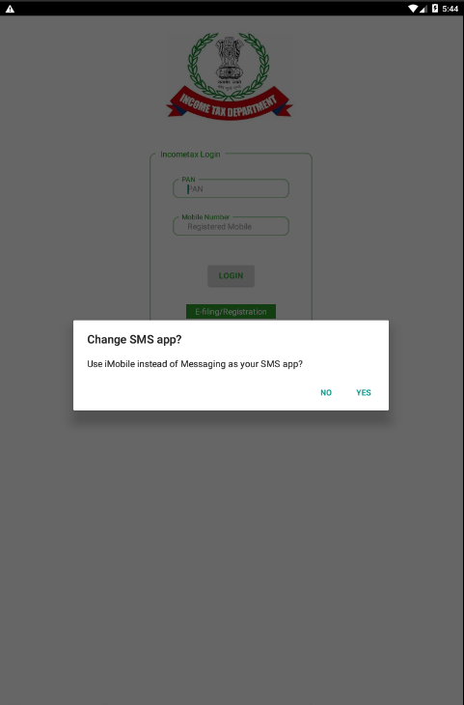
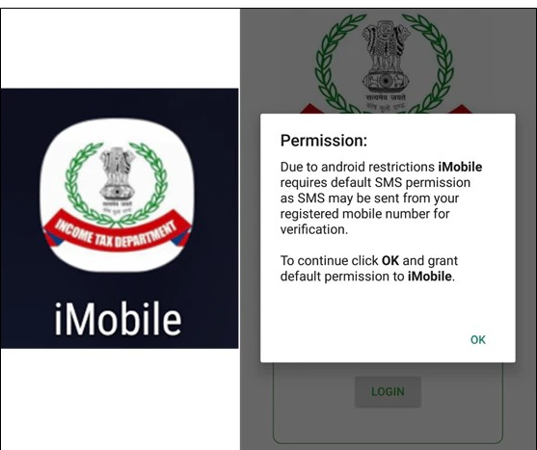
SMS PERMISSION

Slide 25
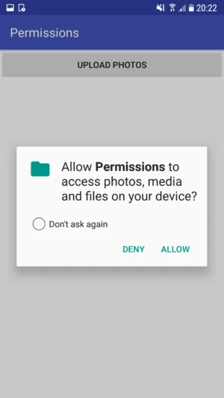
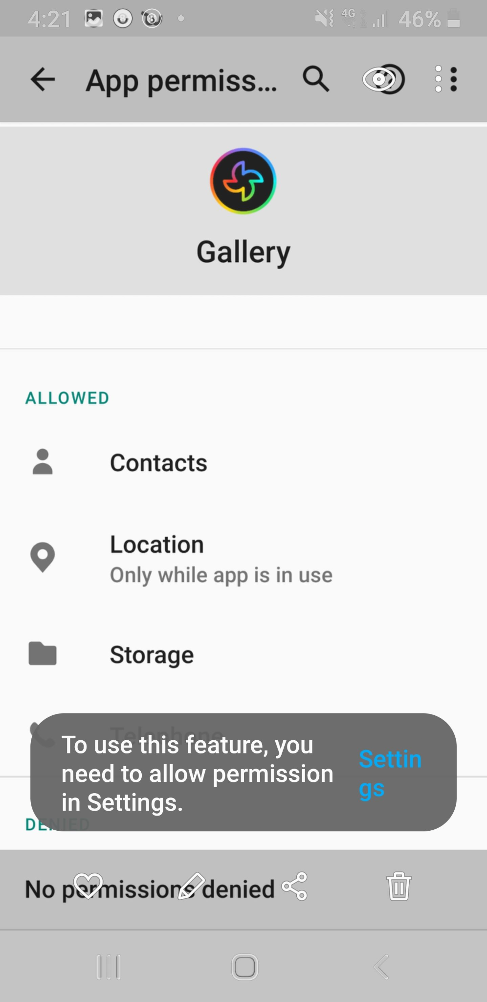
Permissions

Slide 26
EXAMPLE 4

Slide 27
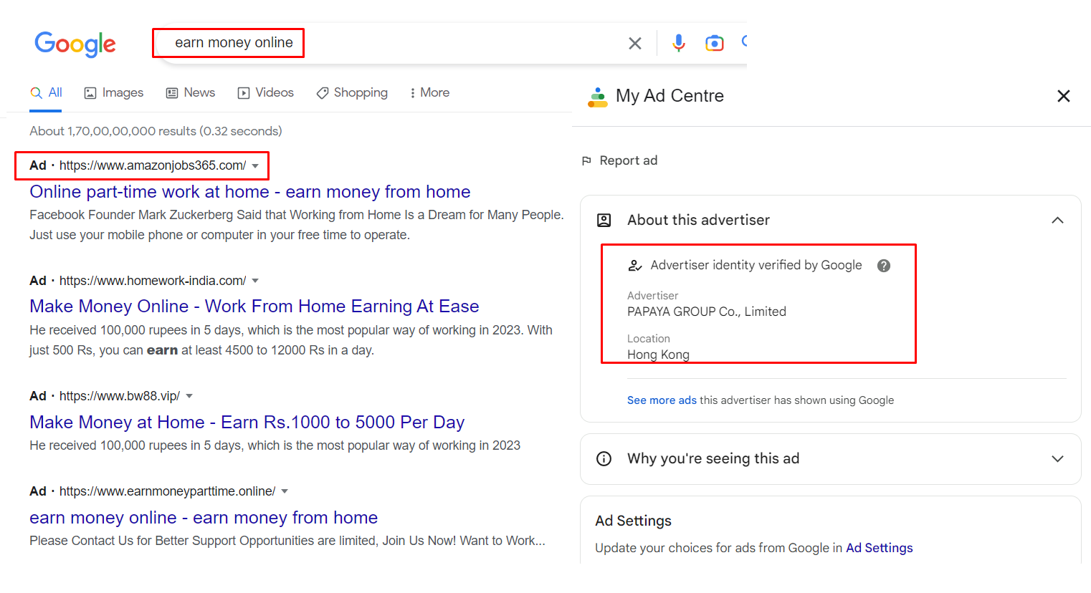
Search Engine

Slide 28
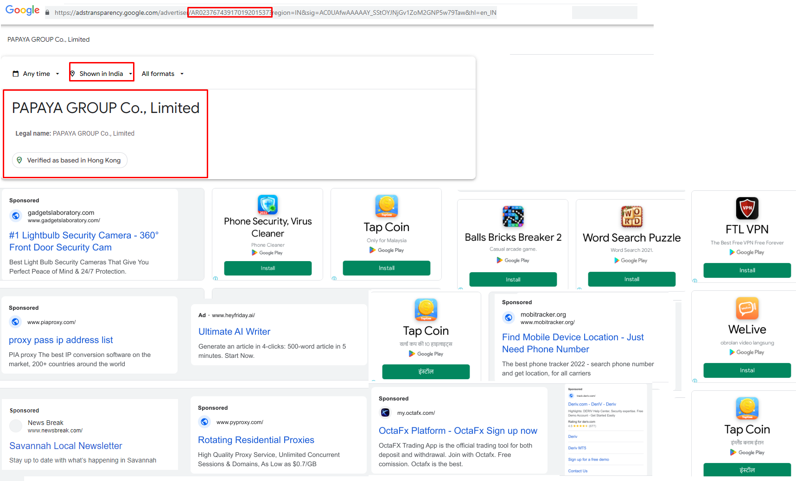
IoT Architecture
Restricted
https://adstransparency.google.com/advertiser/AR02376743917019201537?region=IN&sig=AC0UAfwAAAAAY_SStOYJNjGv1ZoM2GNP5w79Taw&hl=en_IN

Slide 29
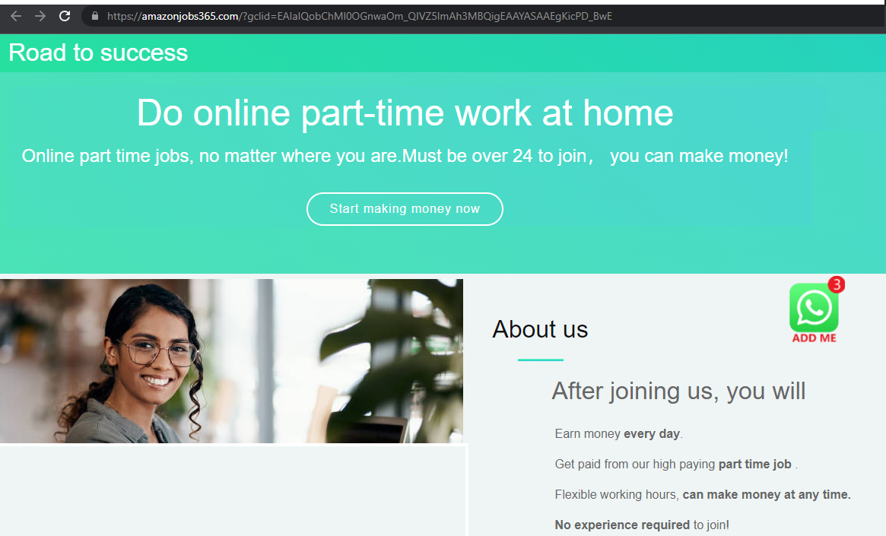
Redirection

Slide 30
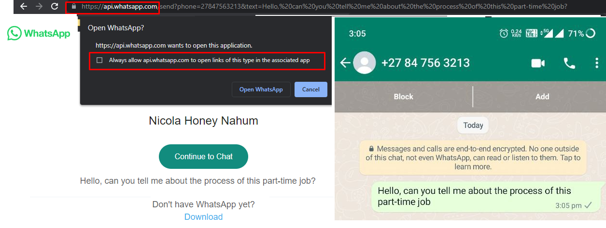
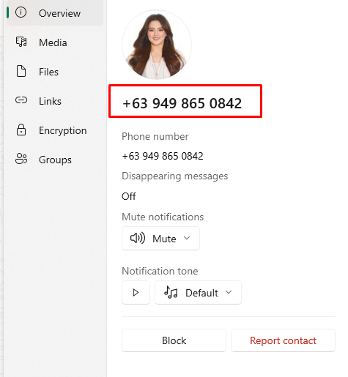
Attack medium

Slide 31
Malware
Today’s cybercriminals often carry out ‘smishing’ attacks because people tend to trust text messages more than emails
Shifting from Teleco SMS to Internet based Messaging platforms
Using malicious and suspicious URLs/domains links to spread malware. Malware is short for “malicious software”
It infects, explores, steals or conducts virtually any behavior and initiate cyber incidents. Also Push Pull agent facility through app
Misuse of Unstructured Supplementary Service Data (USSD) code such as call forwarding
Fake SMSs, Use of SMS bombers through mobile application and online services such as ‘BOMBitUP’, ‘Blast’, ‘Bomber’, etc
Rise in Fake VOIP numbers,
Some of the malwares are:
Virus
Worm
Trojan horse
Spyware
Ransomware
Rootkit
Adware
Keyloggers
Backdoor virus or remote access Trojan (RAT)

Slide 32
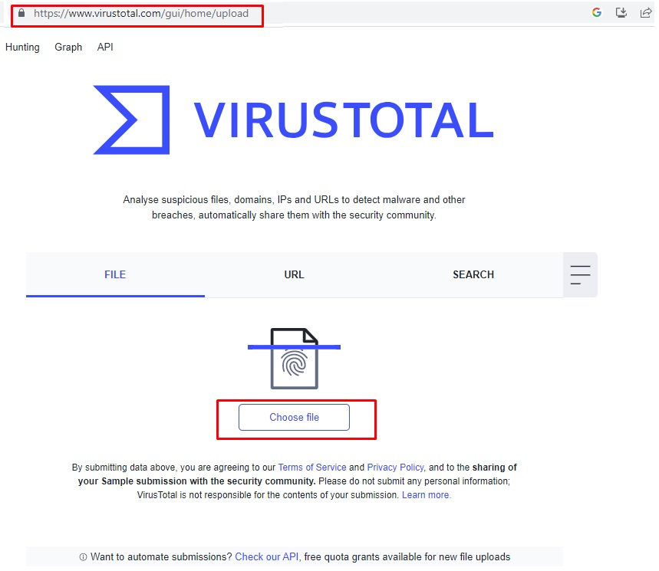
COUNTERMEASURE
https://www.virustotal.com

Slide 33
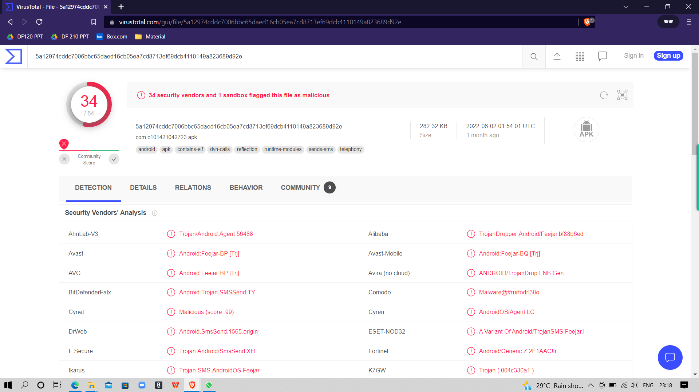
COUNTERMEASURE
Virustotal will give the Output (Whether the APK is Malicious or Not)

Slide 34
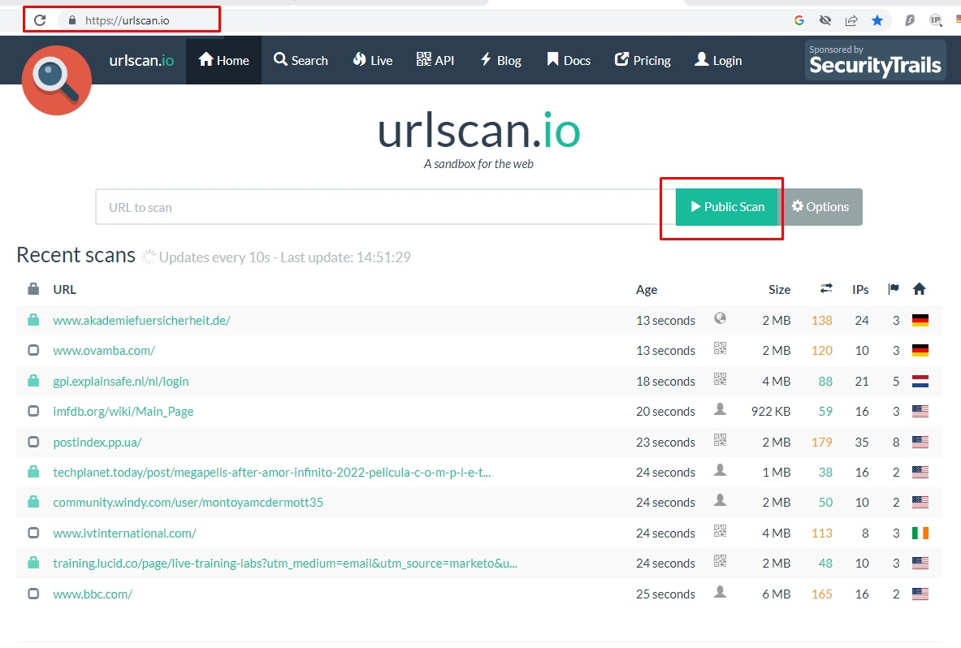
COUNTERMEASURE
https://urlscan.io/

Slide 35
Follow CyberDost
on social media
Get the latest Cyber Safety Tips
Learn about various types of Scam Alerts
Get updates on National and International Cyber news
Learn about the achievements in the attempt to make the nation cyber safe
Become a Cyber Volunteer and share the CyberDost content with your community
Do your bit to stay vigilant and stay cyber safe!

