Slide 1
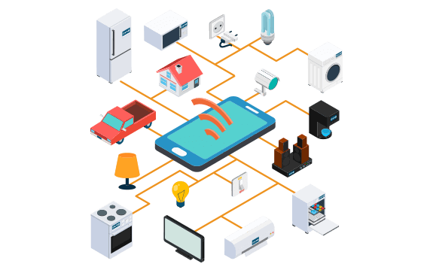
Internet of Things ( IoT ) and Mobile Security
Securing IoT Devices
Securing IoT Devices

Slide 2
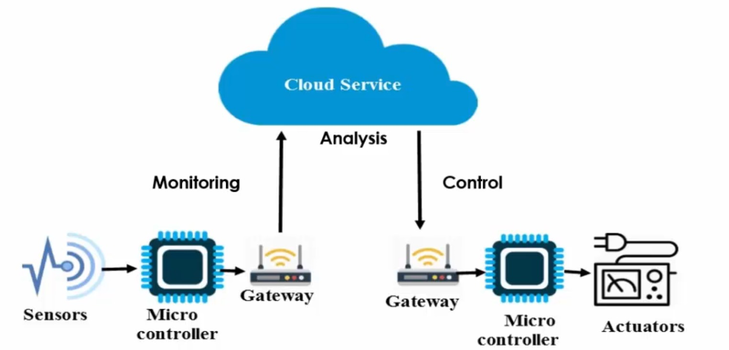
Internet of Things

Slide 3
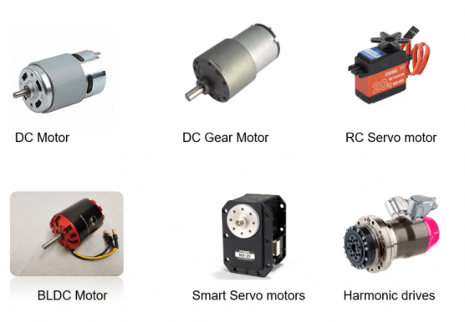
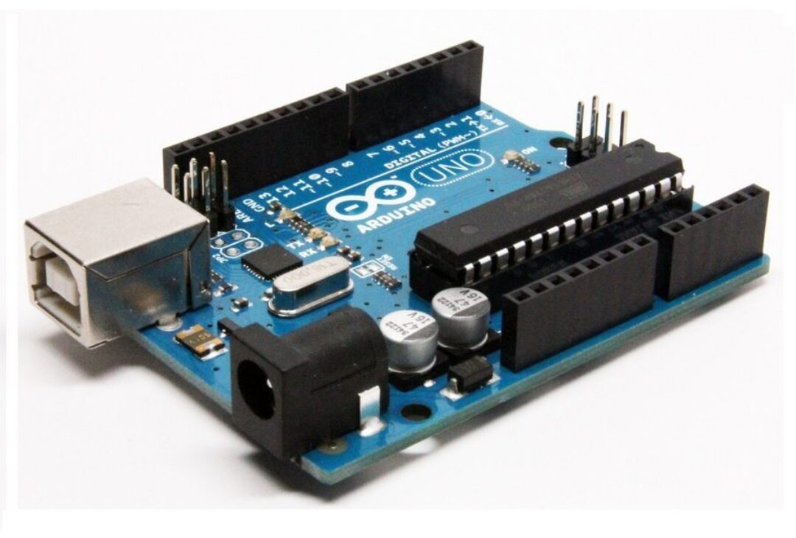
Internet of Things - Components
Sensors
Microcontroller
Actuators

Slide 4
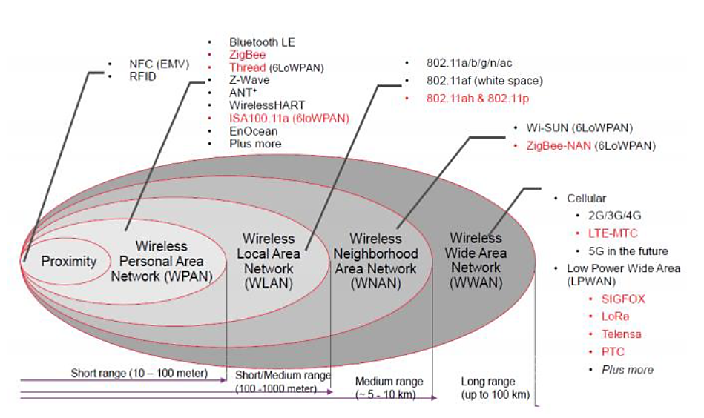
Communication technologies in IoT domain
5G, Wi-Fi 6, WiFi 6E, WiFi HaLow, Bluetooth Mesh

Slide 5
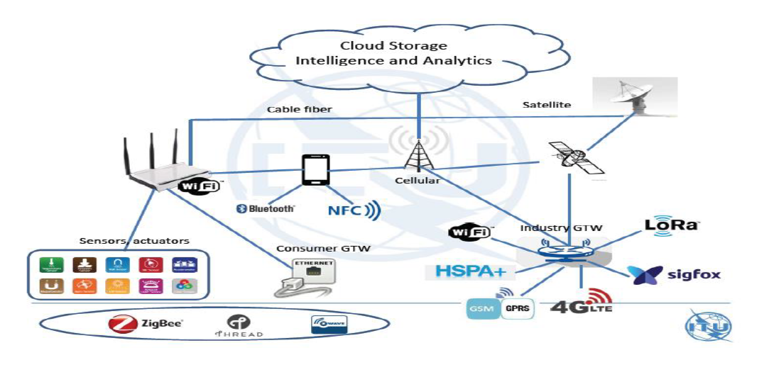
Definition of IoT
A global infrastructure for the information society, enabling advanced services by interconnecting (physical and virtual) things based on existing and evolving interoperable information and communication technologies

Slide 6
Concerned Organisations & Initiatives
TEC - Telecommunication Engineering Centre
ITU - International Telecommunication Union
SG20 - IoT and Smart Cities & Communities - NWG 20 by TEC
oneM2M - one Machine to Machine
TSDSI - Telecommunications Standards Development Society of India

Slide 7
IoT Applications
1
4
Smart Cities
Intelligent transport System, Waste management, Water distribution, Smart Parking, Safety & Security
Utilities / Energy
Smart metering, smart grid, Electric line monitoring, gas / oil / water pipeline monitoring
2
5
Health Care
Remote patient monitoring / diagnostics, Tele-medicine, wearable health devices
Transport System
Vehicle tracking, V2V and V2I applications, traffic control, Navigation, Infotainment
3
6
Smart Home
Security & alarm, Connected appliances, Smart lighting system
Public safety system
Commercial & home security monitoring, alerts, Fire alarm, Police / medical alert

Slide 8
Security challenges for IoT devices
1 | IoT products are generally deployed in insecure / exposed environments
2 | Limited security planning and weak OS & application architecture
3 | Limited capabilities such as processing, memory and power
4 | Due to the fragmentation of standards & regulations
5 | Difficult security integration of entire network
6 | lack of secure Over-the-Air (OTA) Updates for IoT software & firmware

Slide 9
Privacy Issues
1 | Collection, use and disclosure of IoT data
2 | De-identification of IoT data
3 | Consent (capacity, voluntary, current, specific and informed)
4 | Dependency on vendors
5 | Interoperability
6 | Managing IoT devices
7 | Accountability and Transparency

Slide 10
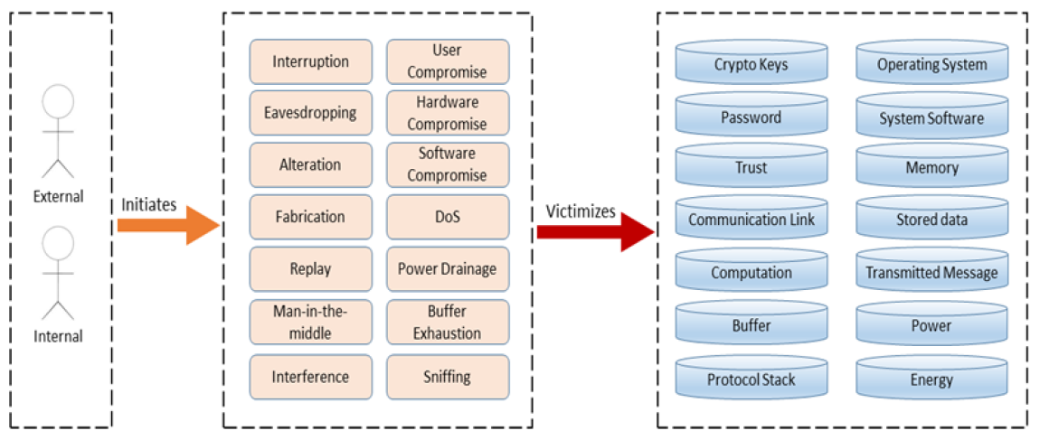
Threats in IoT environment
Threat Agent
Threats
Assets

Slide 11
Mirai Botnet
The Mirai botnet attack targeted the DNS service provider Dyn in October 2016. As a result of the attack, numerous major websites and online services, including Twitter, Reddit, Spotify, GitHub, and many others, experienced disruptions or outages due to the compromised IoT devices overwhelming Dyn's servers with a massive distributed denial-of-service (DDoS) attack.

Slide 12
Distributed Denial of Service Attack (DDoS)
A DDoS attack is a malicious attempt to disrupt the regular functioning of a network, service, or website by overwhelming it with a flood of internet traffic.
Key characteristics:
Distributed nature
Multiple sources
High volume of traffic
How Does a DDoS Attack Work?
Step 1: Botnet creation
Step 2: C&C communication
Step 3: Attack launch
Step 4: Victim overwhelmed
Step 5: Service disruption

Slide 13
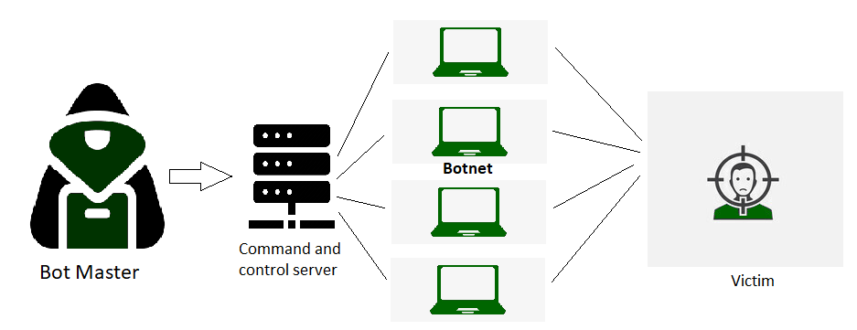
Distributed Denial of Service Attack (DDoS)

Slide 14
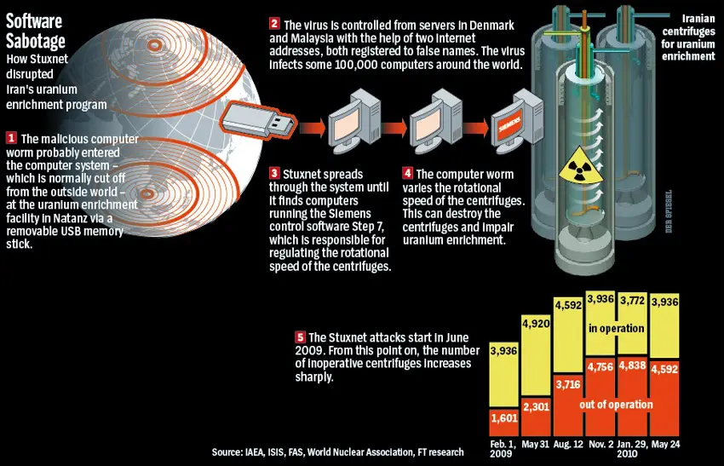

Slide 15
Attack on IoTs
DDoS attack Message Interception attack (MIM) Timing attack (side channel attack) Injection attack Crypto Jacking | SPAM attack Replay attack Node capture attack Vulnerable 3PP library

Slide 16
WiFi Router Vulnerabilities
WiFi Attacks
Evil Twin Attack
Jamming Signals
Misconfiguration Attack
Honey Spot Attack
Unauthorized/Ad hoc Connection Attack
Precautions
Avoid public WiFi networks
Use VPN connection if you have to use public WiFi network.
Always change the default credentials of your router.

Slide 17
Bluetooth Vulnerabilities
Always keep Bluetooth in off state when not in use.
Hackers can exploit open bluetooth for-
Bluesnarfing
Eavesdropping
Denial of Service
Viruses and Worms
Bluetooth headsets vulnerabilities
Avoid pairing Bluetooth devices in crowded spaces.

Slide 18
Vulnerabilities of IoT Devices
Security Vulnerabilities
Data Privacy Concerns
Regulatory and Compliance Risks
Network Vulnerabilities
Legacy Systems
Lack of Security Updates
Insecure Communication
Device Manipulation
Supply Chain Attacks
Dependency on Cloud Services
False Sense of Security
Physical Safety Risks

Slide 19
Securing IoT Devices
Choose Reputable Manufacturers
Change Default Credentials
Implement Strong Authentication
Strong Encryption
Secure Communication
Disable Unnecessary Features
Regularly Update Firmware
Network Segmentation
Disable Unused Ports and Services
Implement Firewall Rules
Intrusion Detection Systems (IDS)
IoT Security Standards

Slide 20
Securing IoT Devices
Physical Security
Security by Design
User Education
IoT Security Standards
Regulatory Compliance
Disable Unused Ports and Services
Privacy Considerations
Regular Audits
Vulnerability Monitoring
Hard Configure
Avoid Public WiFi
Guest Network

Slide 21
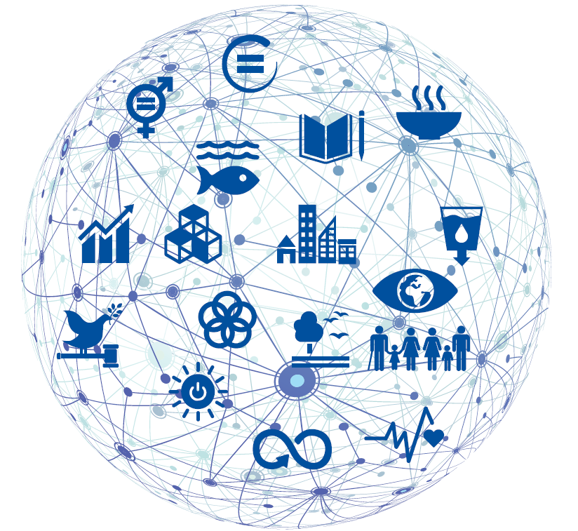
Thanks

