Slide 1
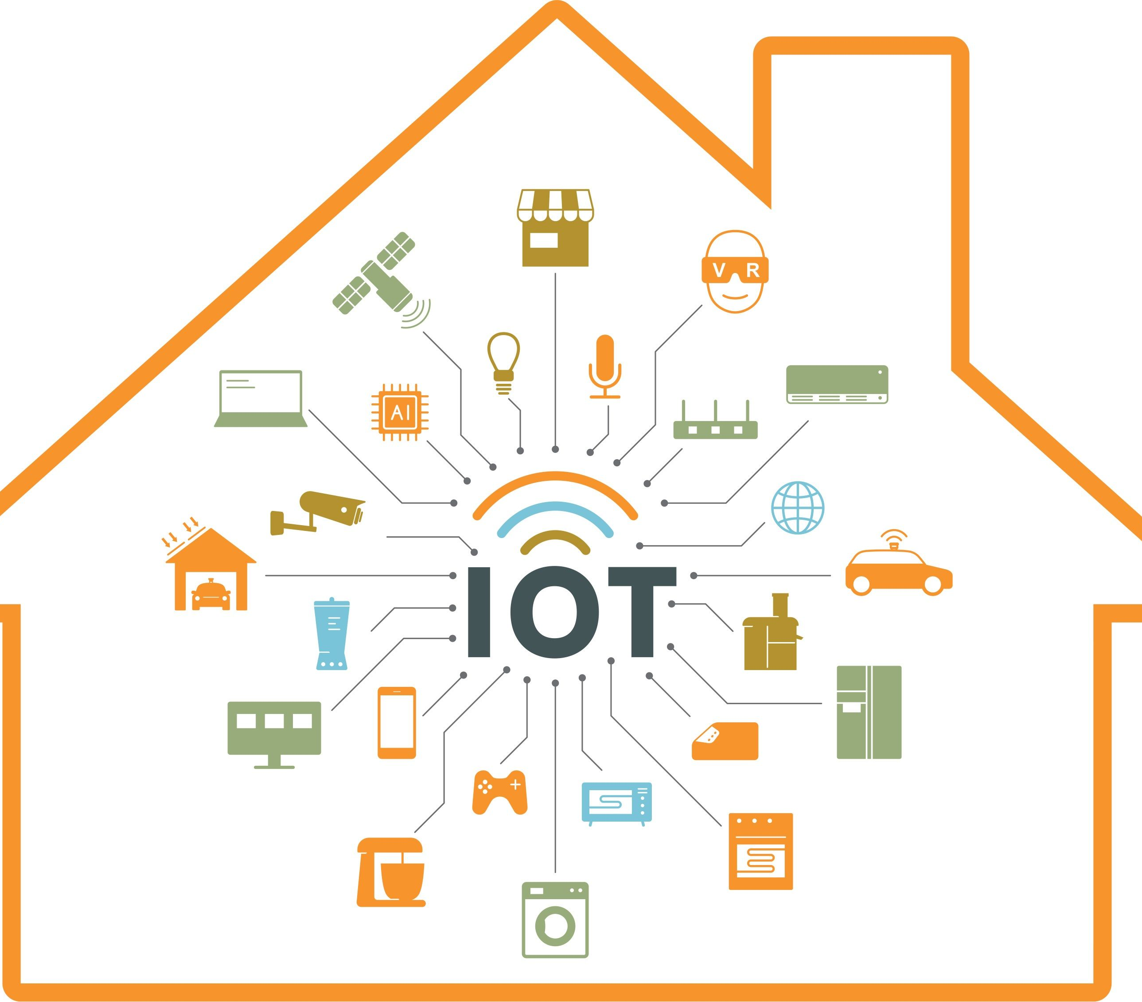

Slide 2
A vulnerability is a flaw or weakness in an asset’s design, implementation, or operation and management that could be exploited by a threat.
A threat is a potential for a threat agent to exploit a vulnerability.
A risk is the potential for loss when the threat happens.
Vulnerability x Threat = Risk

Slide 3
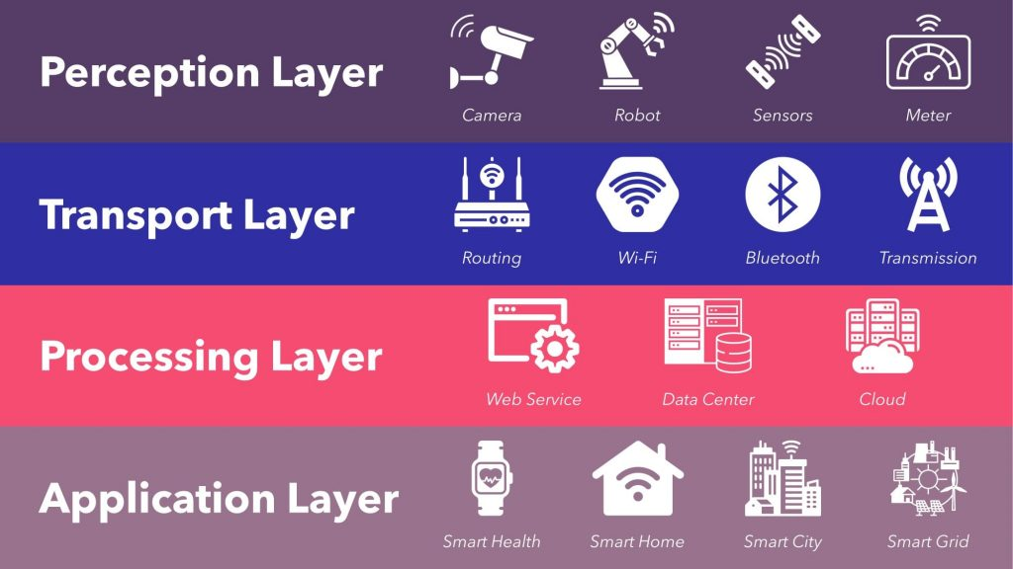
IoT Architecture

Slide 4
Risks of IoT Devices
Cyber criminals an access your heating and lighting system to find out if you are away from home.
Access your password or even your bank account through the information you shared with a digital assistant like Alexa and Google Assistant.
Break-in: The hackers can monitor residents using IP cameras installed in the house.
Get into your network through an IoT device and launch a ransomware attack making your IoT smart home unusable, unless you pay.
Use your devices as BOTs to deliver computing power for DDoS attack, click fraud, password cracking, or send out spam or mine cryptocurrency.
Espionage: Hackers can opt to carry out a campaign where the end goal is the prolonged monitoring or surveillance of a home

Slide 5
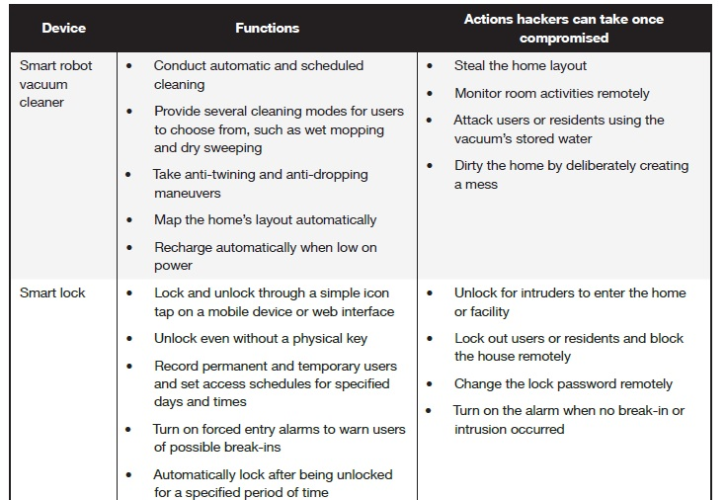
Risks of IoT Devices

Slide 6
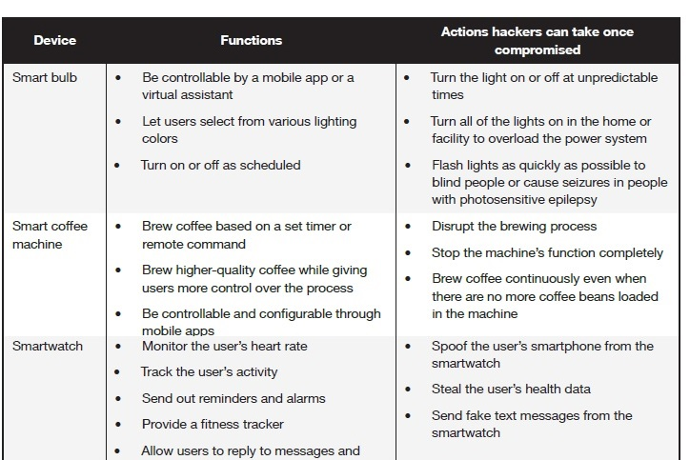
Risks of IoT Devices

Slide 7
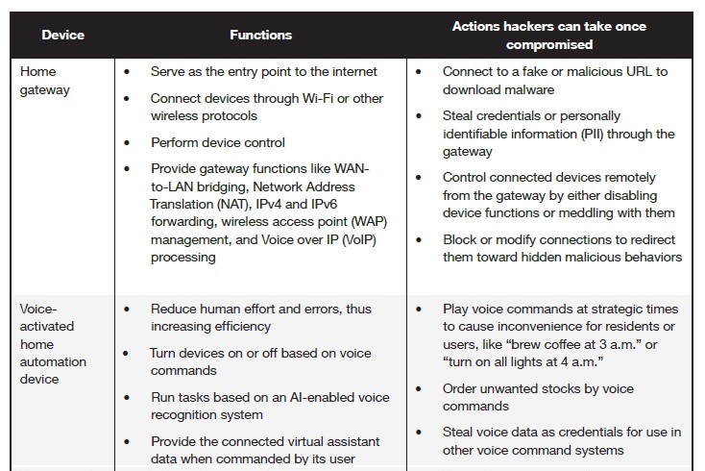
Risks of IoT Devices

Slide 8
Risks of IoT Devices
Amazon explained to ZDNet how it all happened: "Echo woke up due to a word in background conversation sounding like 'Alexa,' the company said in a statement. "Then, the subsequent conversation was heard as a 'send message' request. At which point, Alexa said out loud 'To whom?' At which point, the background conversation was interpreted as a name in the customers contact list. Alexa then asked out loud, '[contact name], right?' Alexa then interpreted background conversation as 'right'. As unlikely as this string of events is, we are evaluating options to make this case even less likely."

Slide 9
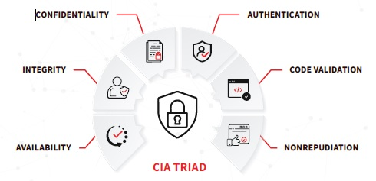
Apply the CIA Triad to Internet of Things Product Design and Security

Slide 10
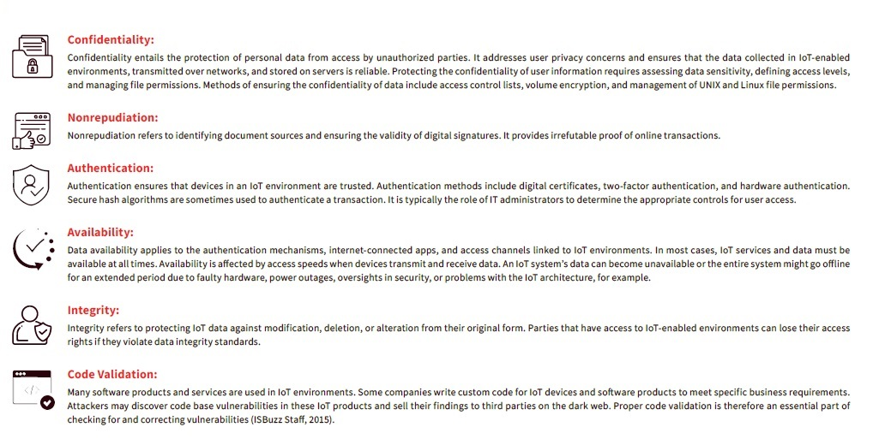
ELEMENTS OF THE AUGMENTED CIA TRIAD

Slide 11
Constant connectivity of the devices
Data sharing
Convenience
Efficiency
Including poor data protection
Poor password protection
Unpatched devices
Poor IoT device management
IoT skill gaps

Slide 12
IoT-related cybercrimes
IOT Botnets and DDoS Attacks
Data Theft and Privacy Breaches
Ransomware Attacks
Unauthorized Access and Control
Supply Chain Attacks
Credential Theft
IoT Device Manipulation
Surveillance and Espionage
Phishing and Social Engineering
IoT-Enabled Vehicle Hacking

Slide 13
IoT Cyber Risks
Weak Authentication and Authorization:
Many IoT devices have weak or default usernames and passwords, making them vulnerable to brute force attacks. Additionally, they may lack robust authorization mechanisms, allowing unauthorized access to sensitive data or control over the device.
Lack of Encryption:
IoT devices often transmit data over networks without proper encryption, leaving data vulnerable to interception and tampering. This is especially concerning when dealing with personal or sensitive information.
Firmware and Software Vulnerabilities: Manufacturers may not provide regular updates and patches for IoT devices, leaving them exposed to known vulnerabilities. Hackers can exploit these vulnerabilities to gain access to devices or compromise their functionality.
Inadequate Device Management:
Managing and securing a large number of IoT devices can be challenging. Organizations may not have effective processes in place for monitoring and updating devices, leading to security gaps.
Data Privacy Concerns:
IoT devices collect vast amounts of data, often without users' explicit consent or knowledge. This data can be mishandled, leading to privacy breaches and potential misuse.

Slide 14
IoT cyber risks
Physical Security: IoT devices deployed in physical environments may be physically accessible to attackers. Tampering with or stealing these devices can compromise security.
DDoS Attacks:
IoT devices can be hijacked and used as part of botnets to launch Distributed Denial of Service (DDoS) attacks on other systems or networks.
Interoperability Issues:
IoT devices from different manufacturers may not always work seamlessly together, potentially leading to security vulnerabilities when attempting to integrate them into a larger IoT ecosystem.
Supply Chain Risks: Compromised or counterfeit IoT components during the manufacturing and distribution process can introduce vulnerabilities into devices before they even reach the end user.
Legacy Devices: Older IoT devices may lack modern security features and cannot be easily updated or replaced, leaving them susceptible to attacks.

Slide 15
IoT cyber risks Mitigation
Change default passwords and usernames on IoT devices.
Regularly update device firmware and software.
Implement strong encryption and authentication mechanisms.
Segment IoT devices from critical networks when possible.
Monitor network traffic for unusual activity.
Establish and enforce IoT security policies.
Educate users and employees about IoT security best practices.

Slide 16
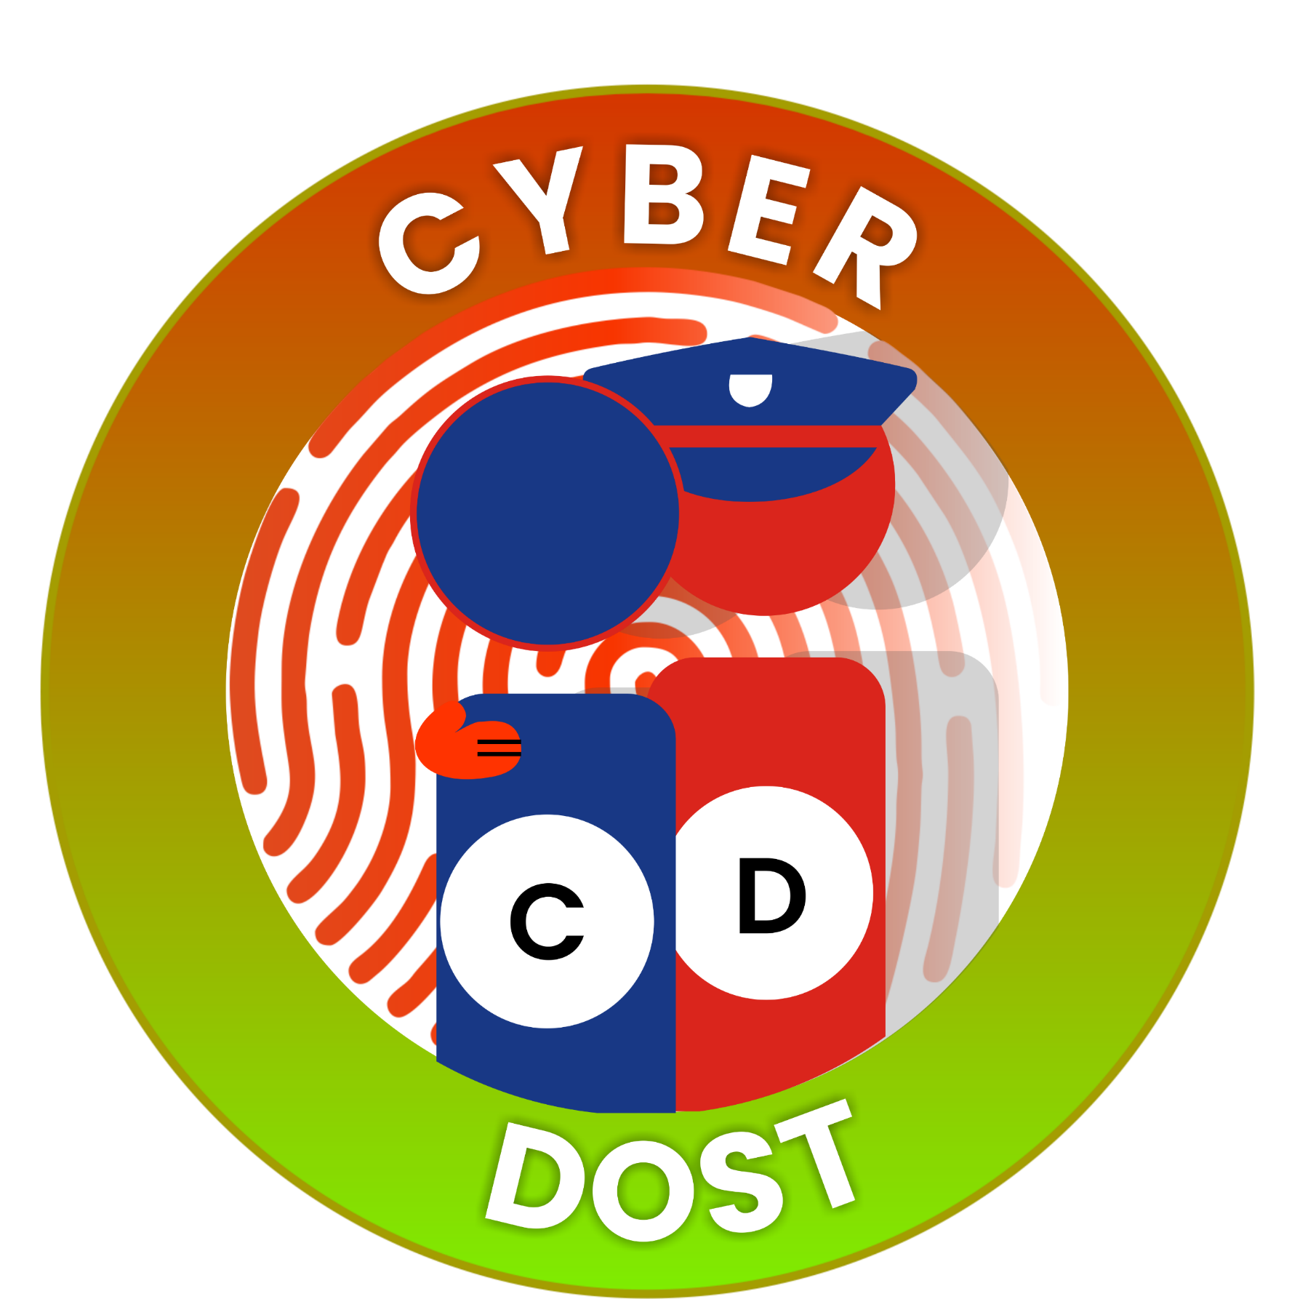
Follow CyberDost
on social media
Get the latest Cyber Safety Tips
Learn about various types of Scam Alerts
Get updates on National and International Cyber news
Learn about the achievements in the attempt to make the nation cyber safe
Become a Cyber Volunteer and share the CyberDost content with your community
Do your bit to stay vigilant and stay cyber safe!

