Slide 1
Internet of Things (IoT) & Mobile Security
Indian Cyber Crime Coordination Center,
Ministry of Home Affairs
Date : 04-09-2023

Slide 2
Session Outline
Understanding Internet of Things
Usefulness of IoT
IoT Cyber Security Issues
Safe Use of Internet of Things
Mobile Security
Network and Device Security
Data Security

Slide 3
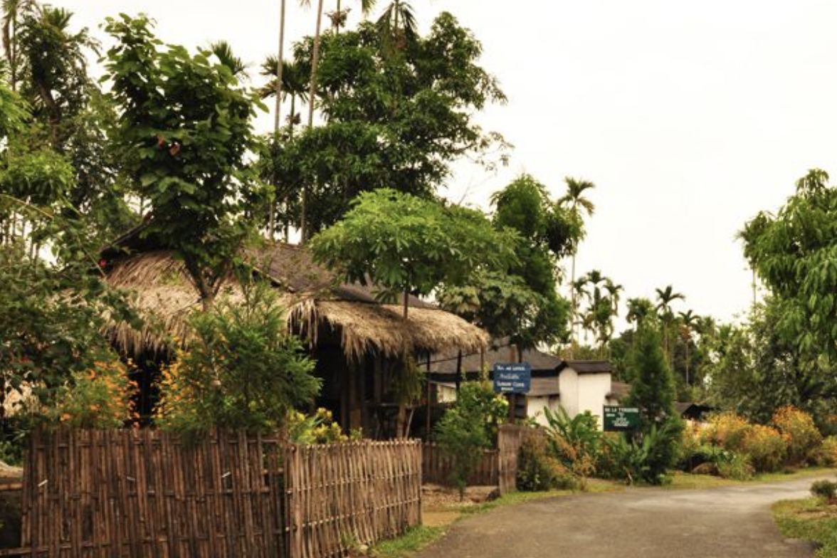
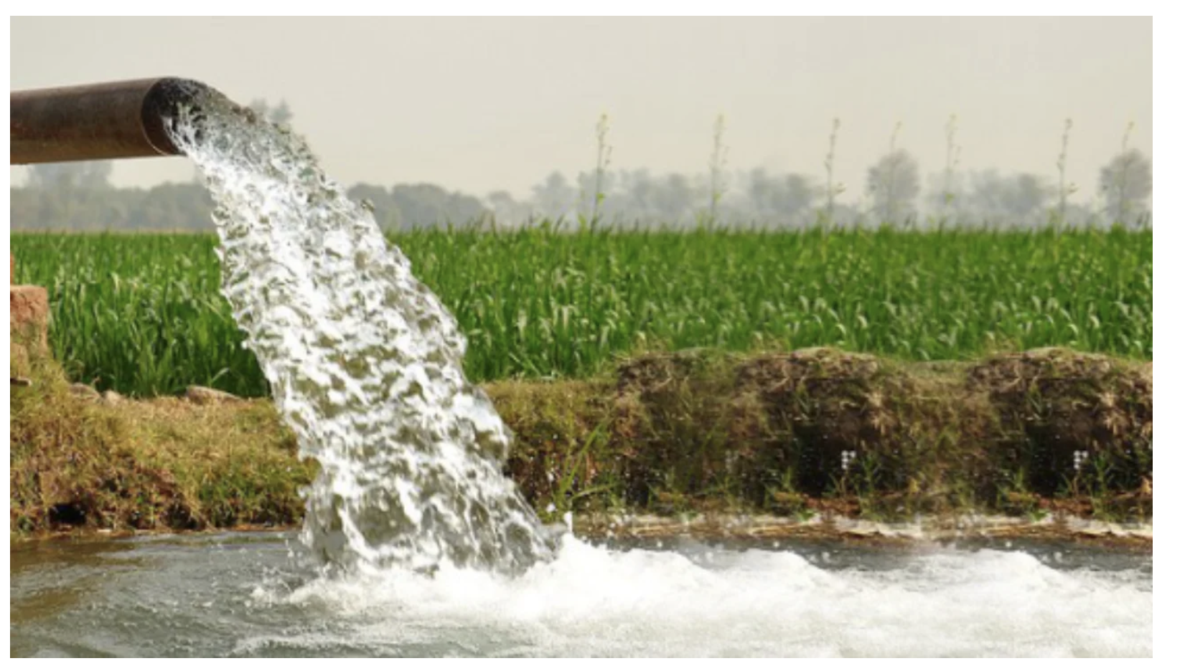
A real Problem….
Travel Time 2 Hours : Switch ON and OFF the Motor

Slide 4
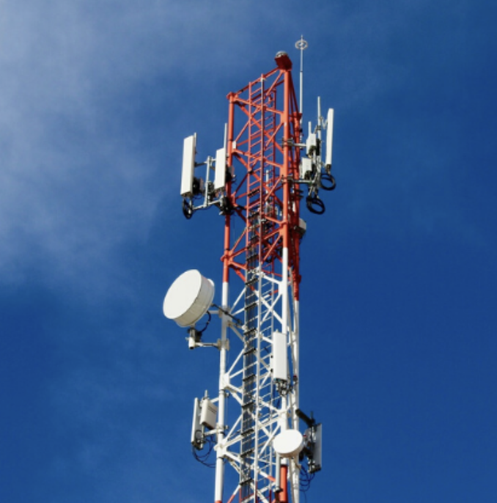
Solution - IoT
Internet
Mobile App to control Motor
Internet (Mobile Data) connected Motor

Slide 5
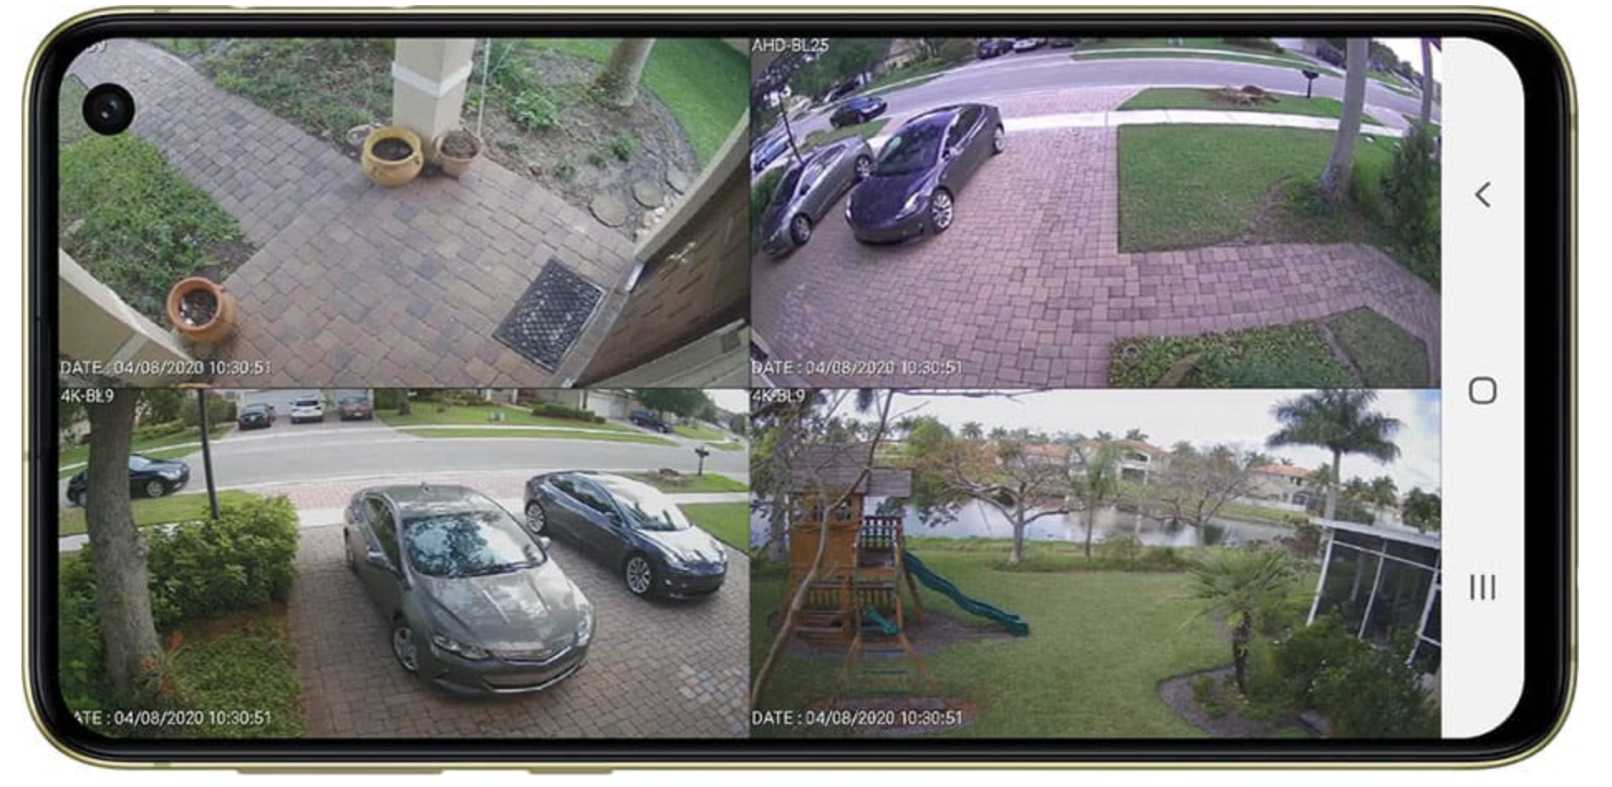
IP Cameras : Convenient, Economic

Slide 7
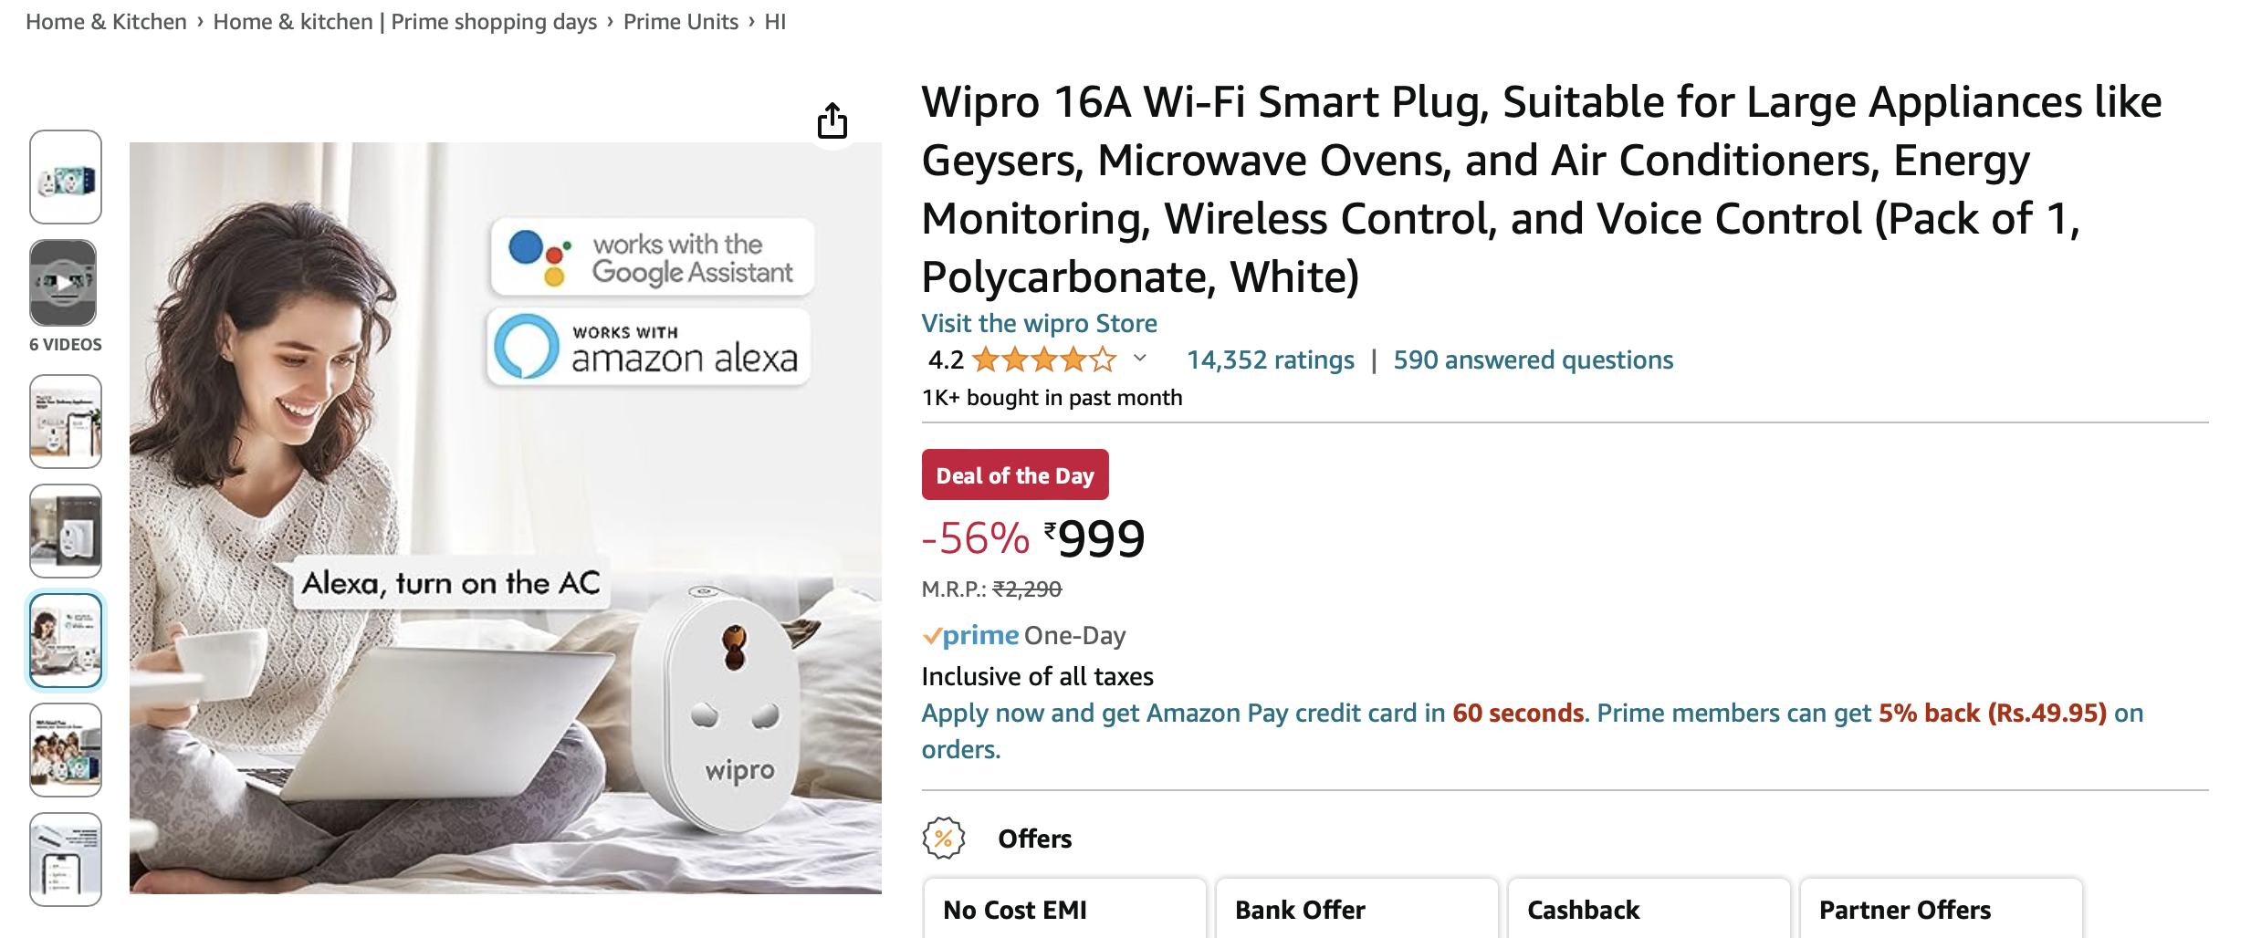
IoT : Affordable and widely used (Demo)

Slide 8
Home

Slide 9
Medical
einfochips.com

Slide 10
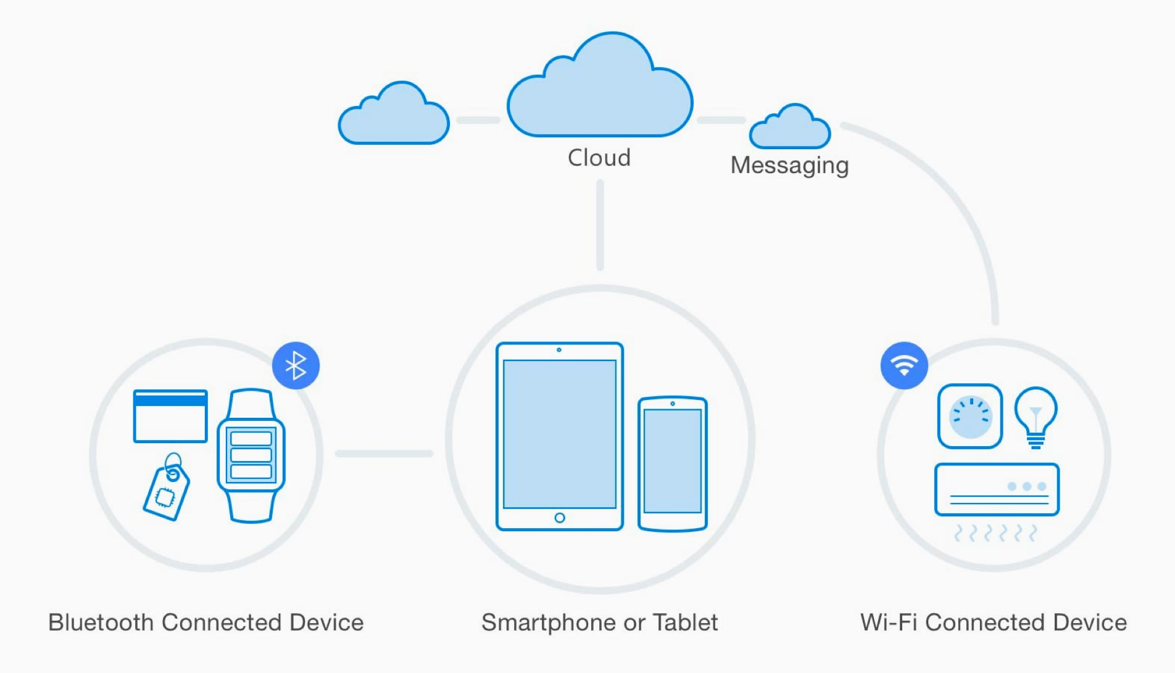
How does IoT Work ?
1. Things (Devices)
2. Connectivity
3. Server
4. Mobile App / Software
Control / Operate IoT Devices.
Camera
Temperature Sensor
Electrical Equipment
Cars
Wi-Fi
LAN / Broadband
Bluetooth
NFC etc.
Software to read and process data / signals

Slide 11
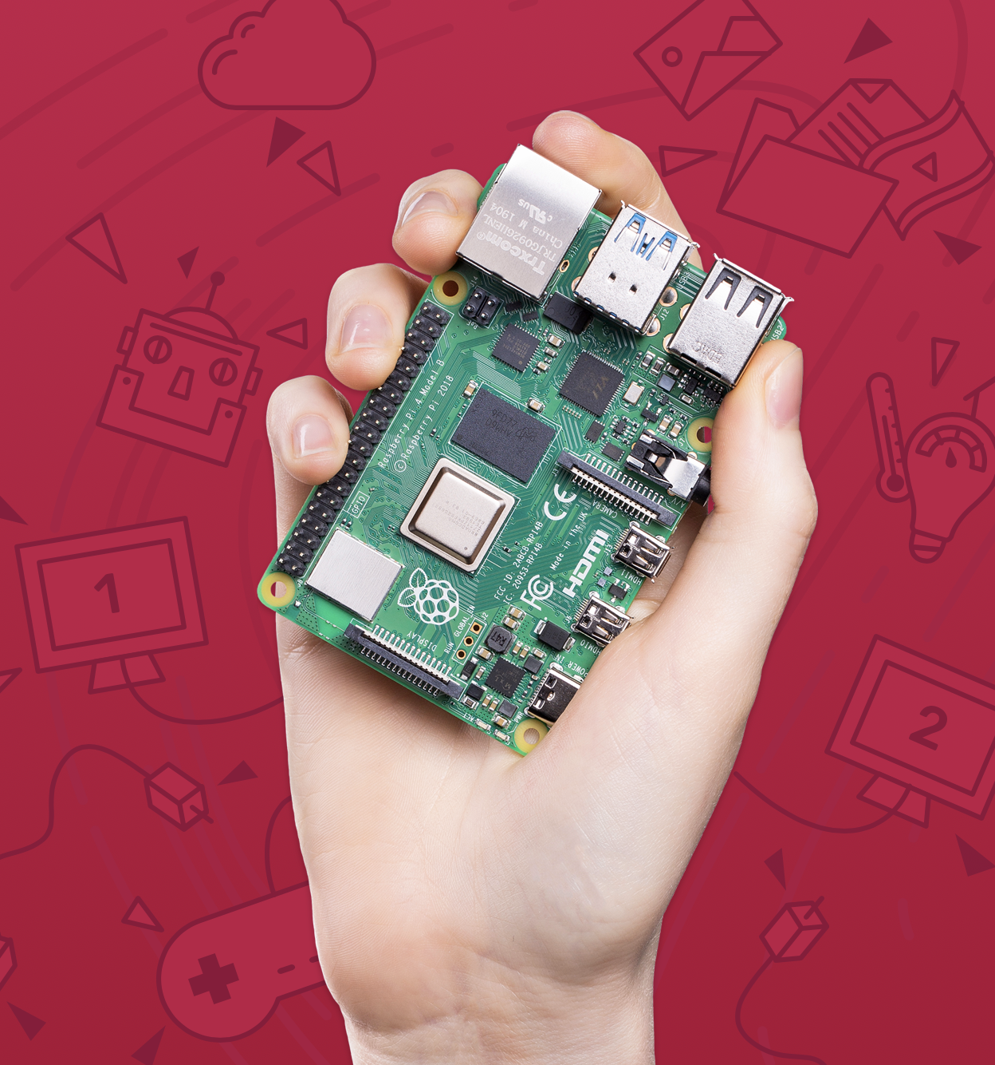
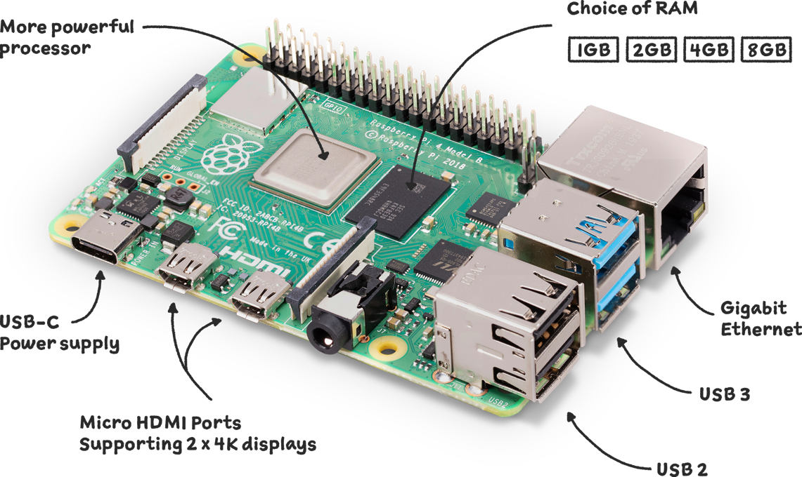
Make students familiar with IoT
Raspberry Pi – A Mini Computer.

Slide 12
Essential Skillsets
Python Programming
Linux Fundamentals
Networking
Basic Hardware

Slide 13
IoT – Cyber Security Issues
Malware / Virus
Data Leak
Insecure Communication
Software Vulnerabilities
Cyber Attack

Slide 14
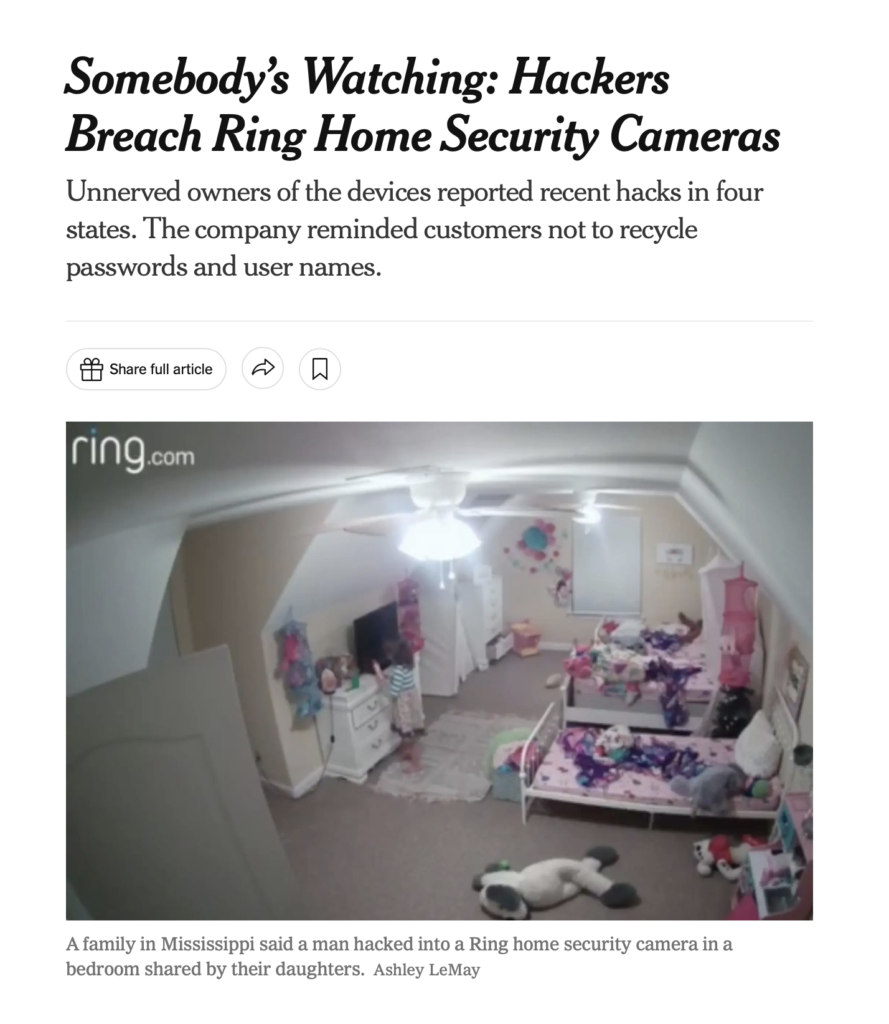
Why do you need security ?
Source : NYTIMES

Slide 15
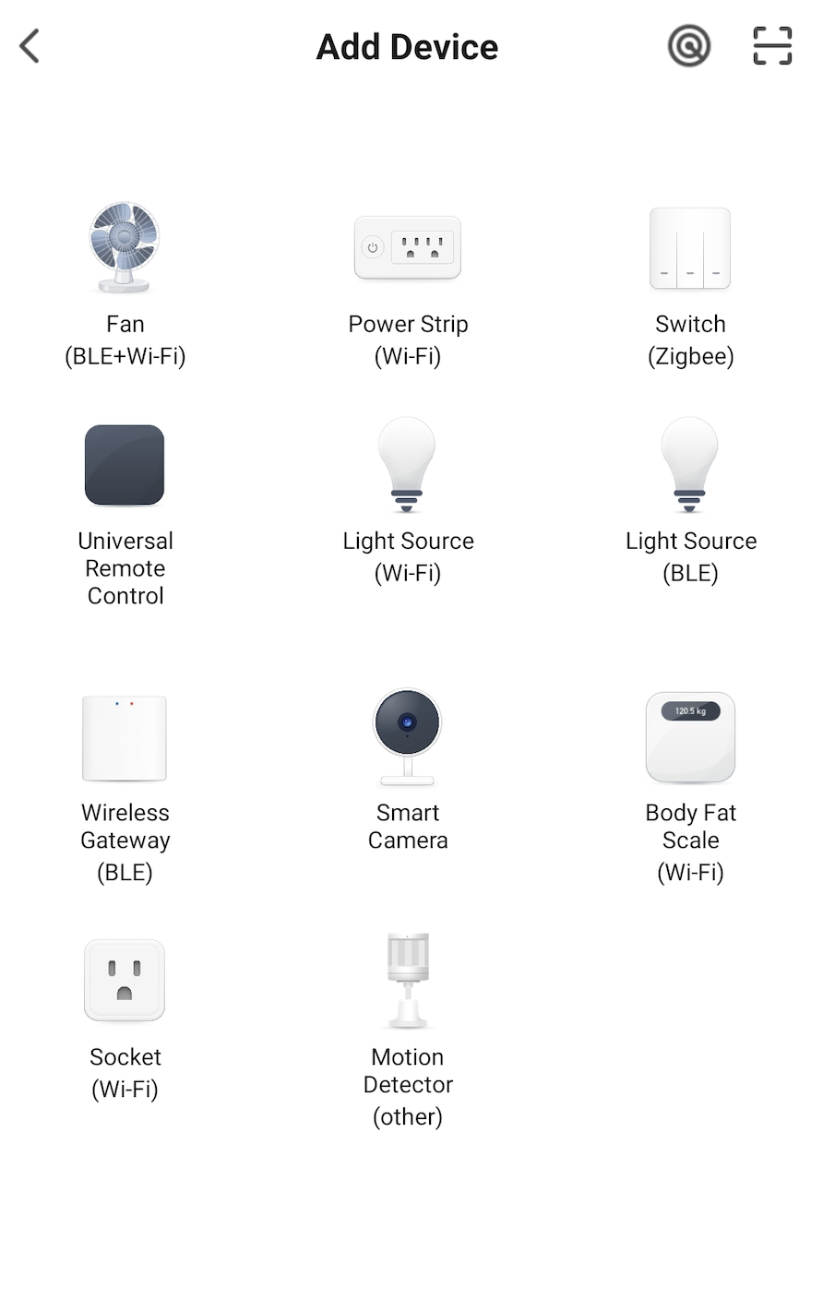
1. Mobile Security
Large number of IoT devices controlled from Phone.
If your phone is controlled by someone else, it is a Risk
Be judicious with Mobile Apps.
Use Antivirus Software on Phone.
Buy only trusted IoT platforms / Devices

Slide 16
2. Network & Device Security
Use Strong Wi-Fi Password.
Change default passwords
Regularly update your firmware

Slide 17
3. Data Security
Backup your data
Do not share any confidential data unless absolutely necessary.
Lock your device access with strong password.

Slide 18
Be a Cyber Volunteer
Register on National Cybercrime Reporting Portal (www.cybercrime.gov.in)
create ‘Login Id’.
Mention name of State/UT of your residence and mobile number
Enter OTP received on your mobile on ‘Login Id’ page and ‘submit’.
Registration Step 1” on page “USER VOLUNTEER PROFILE DETAILS”
Upload resume, ID Proof*, Address Proof* and Passport size photograph.
Select Type of Volunteer ship:-
- Cyber Awareness Promoter
- Cyber Expert
- Cyber Volunteer for unlawful content flagger

Slide 19
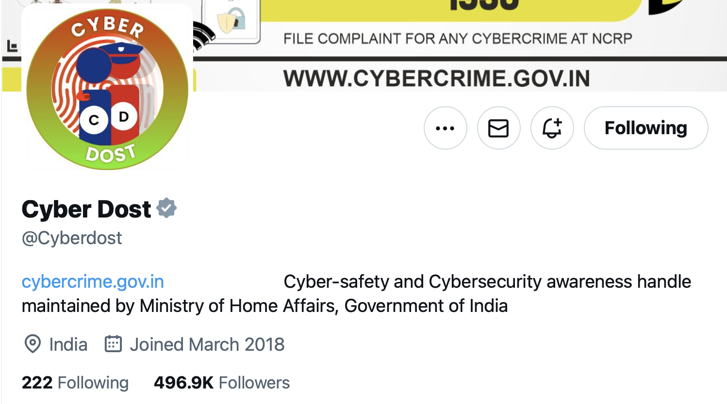
Cyber Dost – Follow on social media
@cyberdosti4c
@cyberdost

